Slide 1
Support Finder
Enhanced Digital Experience
January 10, 2025

Slide 2





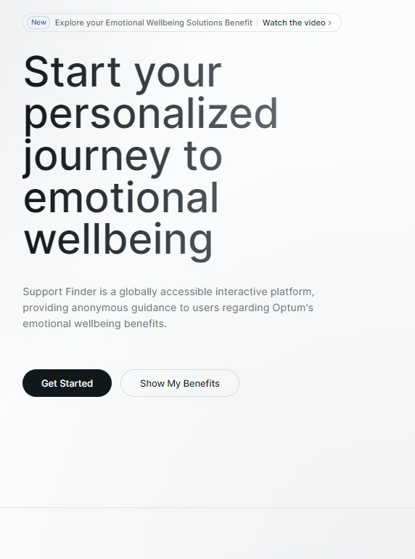

What is Support Finder?
Interactive platform allowing members to anonymously access Optum’s wellbeing benefits
Guided care experience
Personalized recommendations
Self-care app and emotional support
Support includes:
Anonymous and streamlined digital experience
Explore care feature delivers personalized guidance to resources and support
Provider search and online scheduling
Live chat capabilities
Detailed provider background
Various levels of 3rd party integrations and inclusion in outcomes-based reporting
Conversational chat engine with support recommendations
Client-specific, real time reporting dashboard
Available in 27 languages

Slide 3
First Time User
Registration Steps

Slide 4
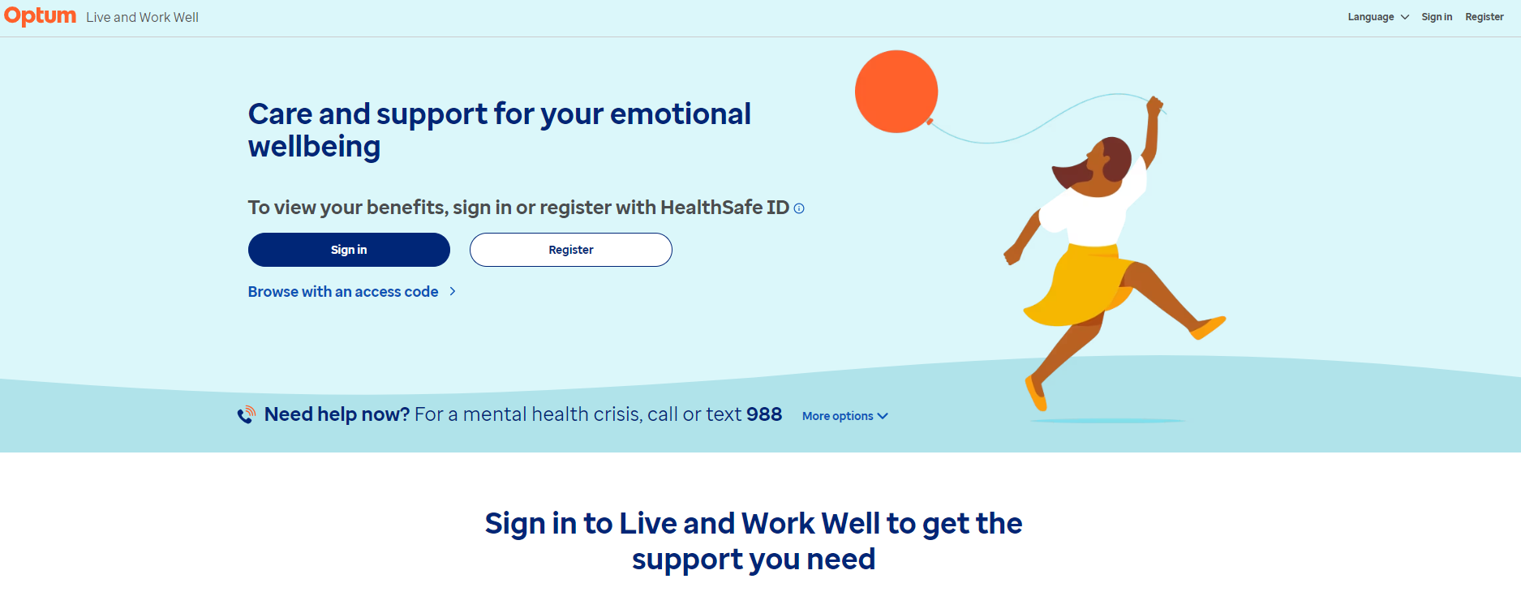
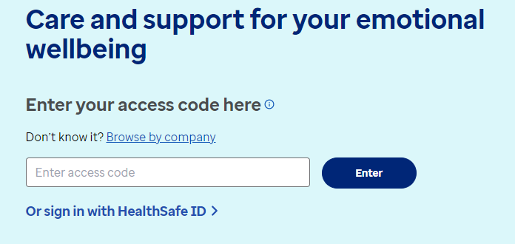
Support Finder: Logging In
Step 1: Land on www.liveandworkwell.com
Step 2:
Click on “Browse with an access code”
Step 3: Enter in your employer’s access code and click enter

Slide 5
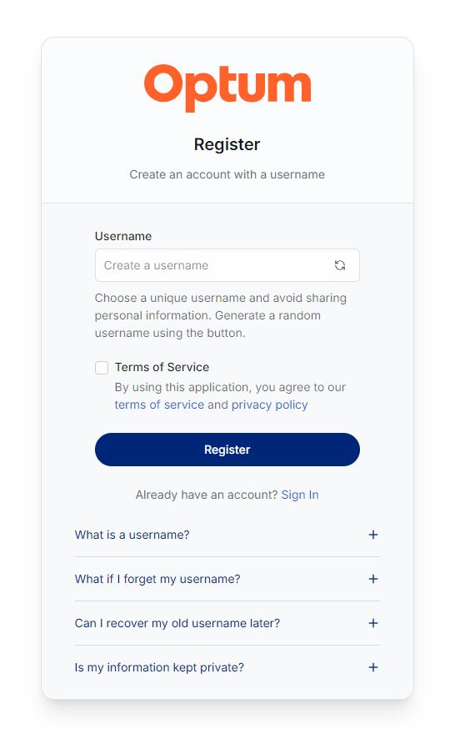
Support Finder: Registering
Once the client access code is entered, first time users will be directed to a username/nickname landing page to Register
This is not a login or Healthsafe ID
Passwords are not required
Username can be a generic name and does not need to include alphanumeric characters. It is only used to add personalization when the member engages in digital chat
Create Username (nickname)
Select Terms of Service
Click on Register button

Slide 6
Logging In
After Registration

Slide 7
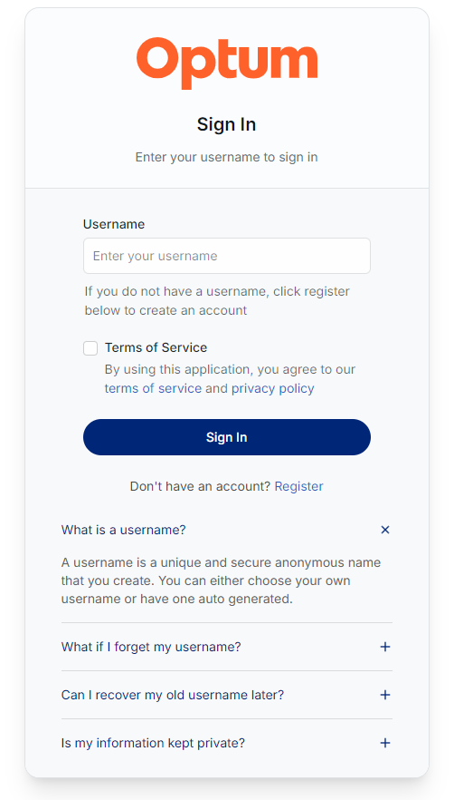
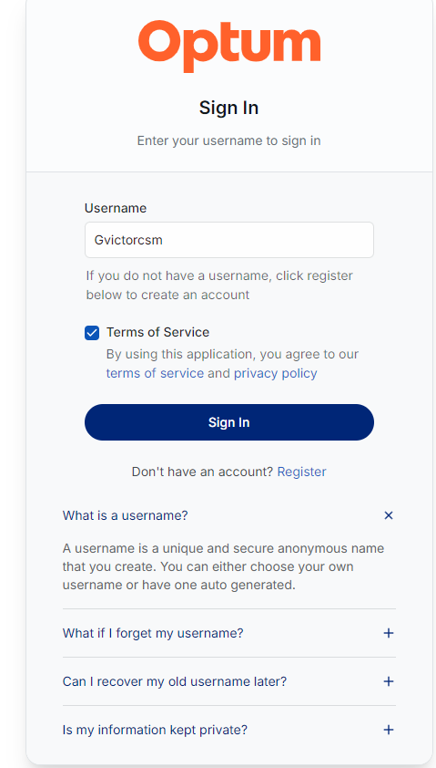
Support Finder: Logging In After Registration
Sign-In Page
Sign-In Page
Will prompt user to sign in after registration
Will be displayed once user has registered
Once a user has registered, the “Sign In” page will display
User should select “Terms of Service” box and Click the “Sign in Button” to begin their guided care experience
    *Note: the username will be stored in their cookies. Should a member clear their cookies, they will need their username to reenter the site. Should a member forget their username, they will need to create a new one to enter the site.

Slide 8
Logging Out

Slide 9

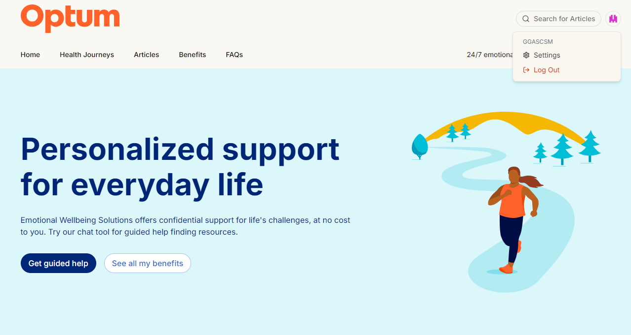
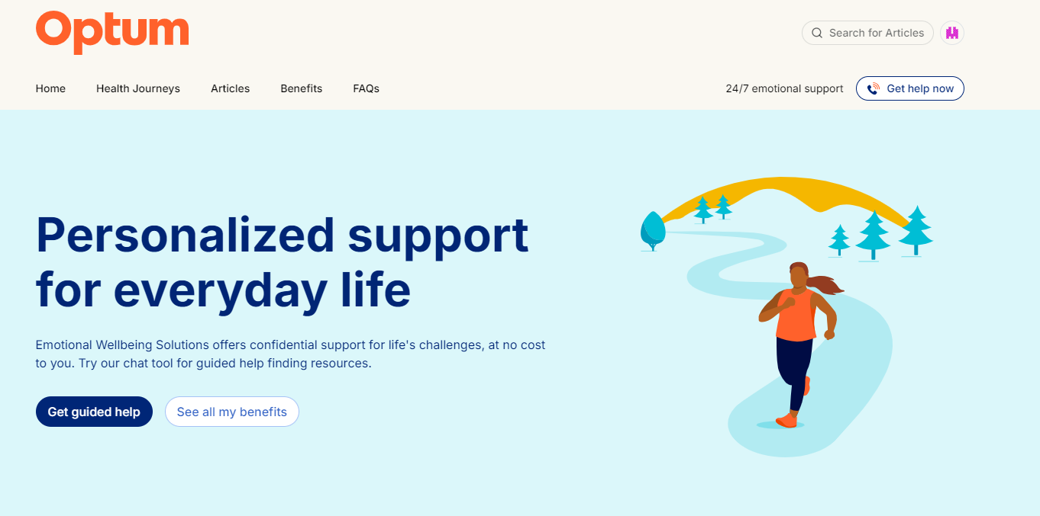
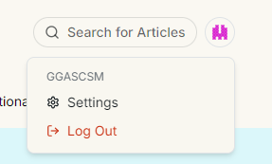
Support Finder: Logging Out
Click the Colored Icon on the Top Right Side of the Menu Bar
Select ‘Log Out’ from the Drop-Down Menu

Slide 10
Frequently Asked Questions (FAQs)

Slide 11





Support Finder: Login/Registration FAQs
What is a Username?
What if I forget my Username?
Can I recover my old username later?
Is my information kept private?
A username is a unique and secure anonymous name that you create. You can either choose your own username or have one auto generated.
If you forget your username, you will need to create a new one. This is important for maintaining your privacy and security.
No, unfortunately, old usernames cannot be retrieved or reset if forgotten. This is for security reasons. You will need to create a new username in such case.
Yes, we maintain anonymity and do not capture or store personal member information. No data is shared with third parties for marketing or advertising purposes.
These FAQs and additional FAQs are available via the web portal

Slide 12

Support Finder: Chat FAQs
All FAQs are also available via the site
Are my conversations and activity confidential?
Yes, you can stay completely anonymous on this site. If you choose to share personal information to access other benefits or chat with an Emotional Wellbeing Specialist, your info and conversations are confidential.
How Do I speak with someone now? To talk to an Emotional Wellbeing Specialist, get the contact phone number and give them a call, 24/7. You can also find this number by selecting Get Help Now in the navigation bar
Can I share this site with my family members? Yes, Emotional Wellbeing Solutions is available to all members of your household, including children living away from home. To share this site, go to settings under your profile avatar, find the “Share link” section and select “copy.” Then you cdan share that link with any family member.
How do I change my current location? Simply go to settings under your profile avatar and find the “Your region” section. Use the dropdown menu to select your regional preference and then save it. If you are going to call and Emotional Wellbeing Specialist, please confirm you have selected your correction location first. When calling from a mobile phone, some countries and regions may charge a toll cost for the call.
How do I change my language preference? Simply go to settings under your profile avatar and find the “Your language” section. Use the dropdown menu to select language preference and then save it

Slide 13
Digital Support
Using Support Finder

Slide 14

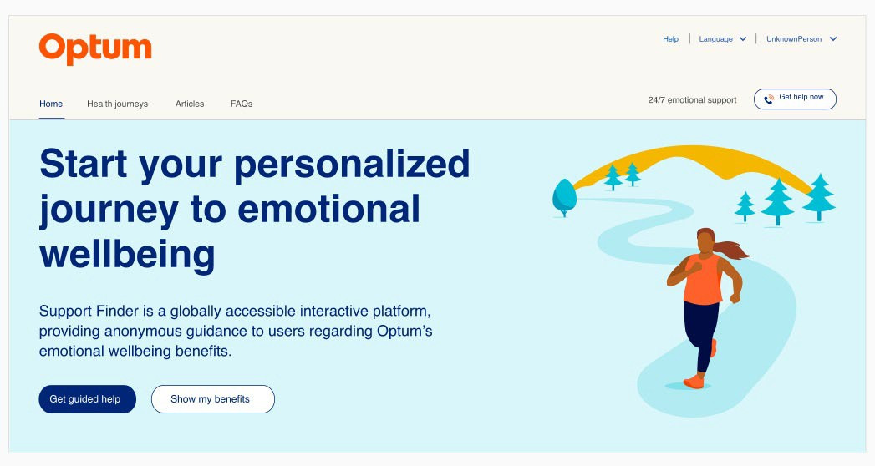

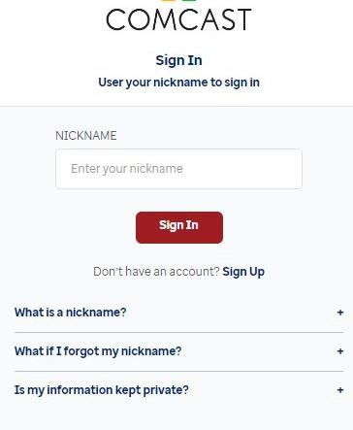

Support Finder: How Can it Help
Live chat available
24/7 in-the-moment support and guidance

Slide 15
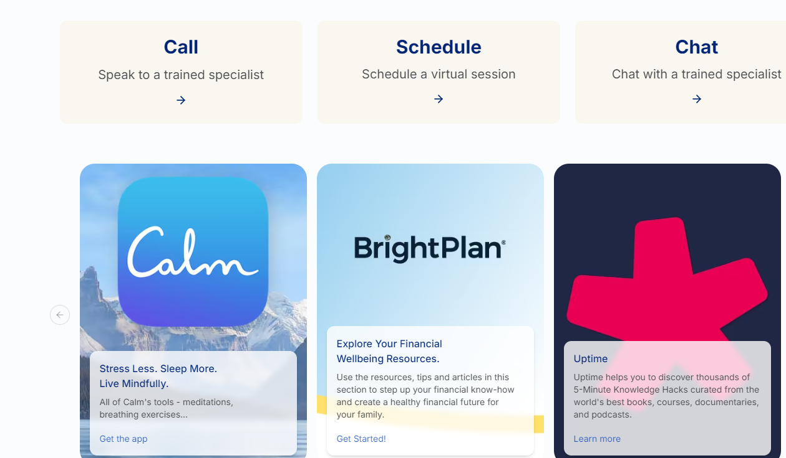
Support Finder: Access to All Digital Resources

Slide 16
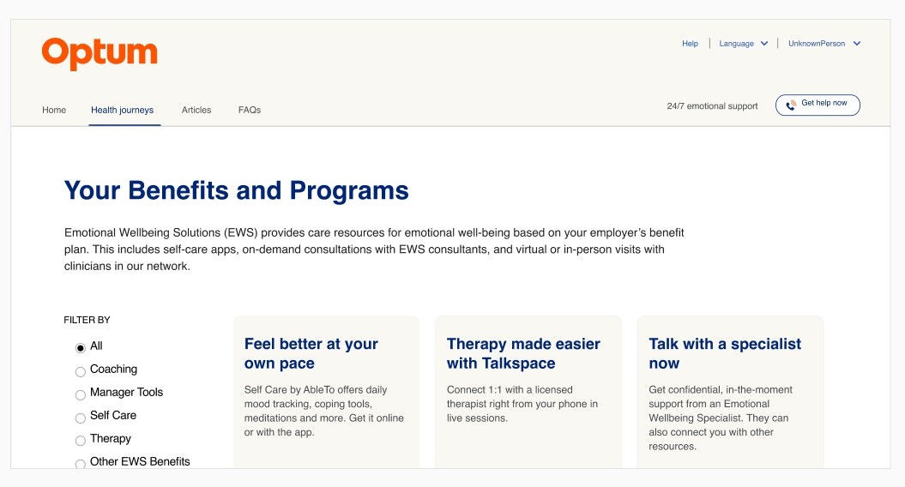
Support Finder: Access All Benefits and Programs

Slide 17
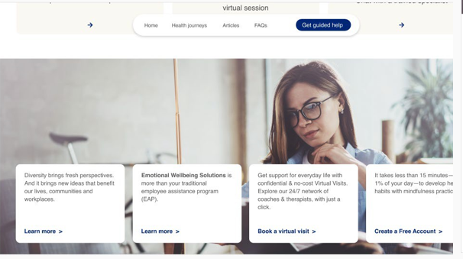
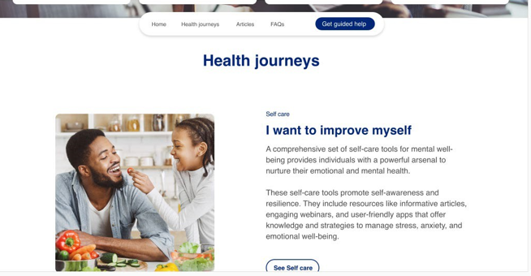
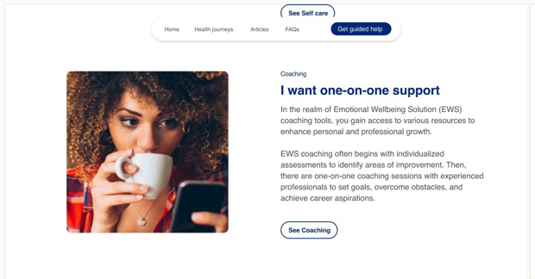
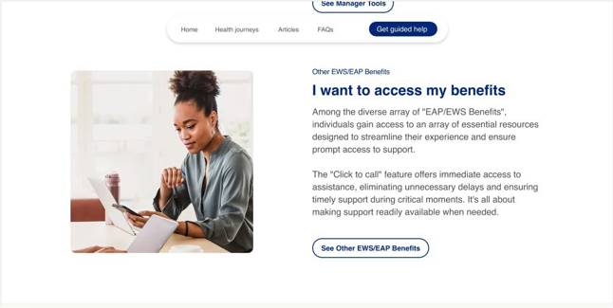
Support Finder: Access to Guided Help
Guided Self Help Tools
Virtual Sessions
Coaching
EWS Benefits

