Slide 1

World TB Day
Best Practices in TB Care and Management
Dr. Sundari Mase, Health Officer
Julia Rubin, Epidemiologist
Ashley Peoples-Flores, Aleah Ockenden, Laurel Ockenden and Michelle Heredia Disease, Control Team

Slide 2
Disclosures
No disclosures or conflicts of interest

Slide 3
Global TB Burden
1/4 of world population infected with TB
Globally, 7.1 million in 2019, this fell to 5.8 million in 2020, back to the level last seen in 2012. In 2021, there was a partial recovery, to 6.4 million (the level of 2016–2017)
An estimated 10.6 million
In 2021, there were an estimated 1.4 million deaths among HIV-negative people and 187 000 deaths among HIV-positive people, a for a combined total of 1.6 million. This was up from best estimates of 1.5 million in 2020 and 1.4 million in 2019
450 000 (95% UI : 399 000–501 000) new cases of rifampicin-resistant TB in 2021.
TB kills one person every 15 seconds

Slide 4
8 countries, 68% of global cases in 2021
87% in 30 high TB burden countries

Slide 5
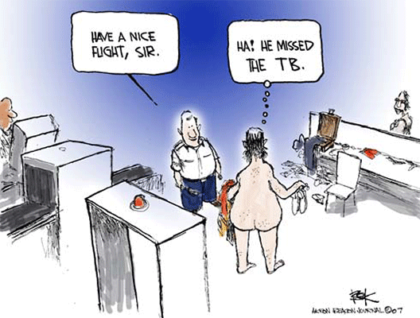
Why do we need to care about TB in the rest of the world?

Slide 6
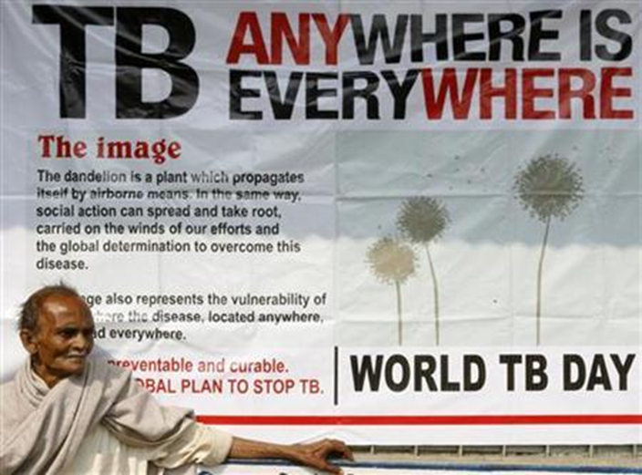

Slide 7
Progress Towards TB Elimination, United States, 1982–2021
26,673 TB cases in 1992
Incidence rate: 10.4 per 100,000
7,882 TB cases in 2021
Incidence rate: 2.4 per 100,000
Notes:
This graph shows the annual number of TB cases in the United States for each year during 1982–2021, and the TB elimination threshold goal of <1 case per 1,000,000 (1 million) population, which is approximately 330 cases per year for the current U.S. population. In 1992, 26,673 cases were reported in the United States, with an incidence rate of 10.4 cases per 100,000 population. TB cases and incidence rates have declined substantially since 1992, but the annual rate of decline has been inadequate to achieve TB elimination goals.
In 2021, 7,882 cases were reported, with an incidence rate of 2.4 cases per 100,000, representing a 9.9% increase in case count and 9.8% increase in incidence rate compared with 2020. This increase might be partially explained by delayed detection of cases with symptom onset during 2020 that were not diagnosed until 2021 because of delayed health care-seeking behavior, interruptions in health care access, or disrupted TB services related to the COVID-19 pandemic. Other factors associated with the pandemic, including changes in immigration, infection prevention strategies, and health service provision, likely had an effect on TB epidemiology in 2021 and ongoing effects will likely continue in the future.

Slide 8
TB-Related Deaths* and Mortality Rates, United States, 1993–2020
600 TB-related deaths in 2020
*National Vital Statistics System Underlying Cause of Death (based on deaths reported through 2020)
Notes:
The National Vital Statistics System (NVSS) reported 600 TB-related deaths (0.2 deaths per 100,000 persons) where TB was the underlying cause of death for 2020, the most recent year for which data are available. This represents a 14.1% increase in deaths and a 13.0% increase in the mortality rate compared with 2019.
It is important to note that under current NVSS guidance, deaths caused by TB among persons with comorbid HIV infections are classified with HIV as the underlying cause of death, not TB, and are not included here.
National Vital Statistics System accessed from CDC WONDER as of July 12, 2022: https://wonder.cdc.gov/

Slide 9
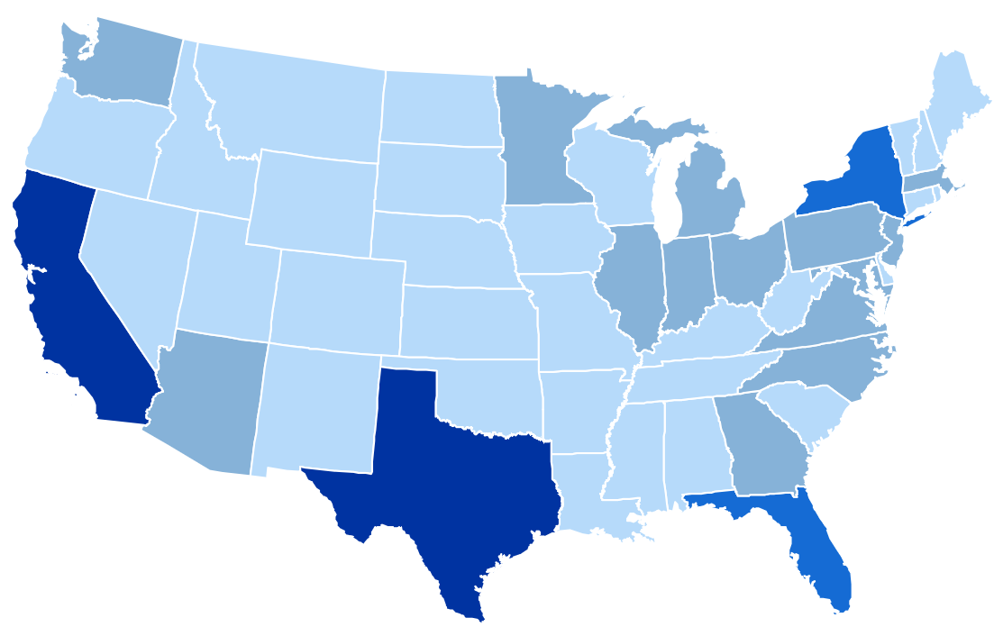


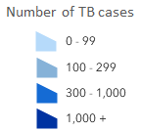
TB Cases by Reporting Area, United States, 2021
California 22%
New York*
9%
Florida
6%
Number of TB cases
≤99
Texas
13%
100–299
300–999
≥1000
* Includes New York City
Notes:
Among U.S. states, close to half (49.9%) of TB cases continue to be reported from 4 states: California (22.2%, n=1,752), Texas (12.7%, n=1,000), New York state (including New York City, 8.7%, n=683), and Florida (6.3%, n=500). These states are also the most populous states in the United States, but only represent about a third of the total U.S. population.
Note: ranges were determined based on the Jenks Natural Breaks method, then rounded to the nearest 100.

Slide 10
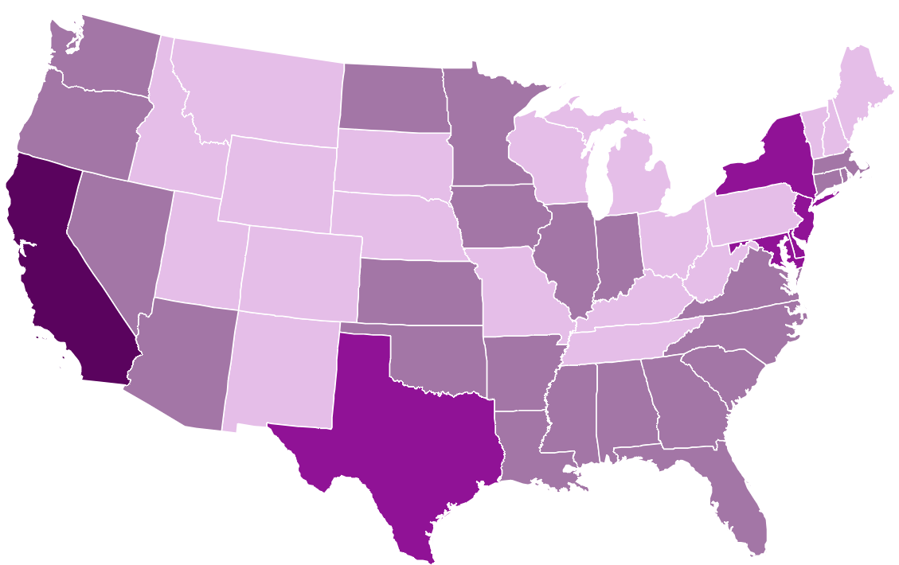



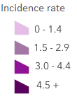

Top 10 TB Incidence Rates* by Metropolitan Statistical Areas (MSAs), United States, 2021
San Francisco
5.8
New York City
4.2
Stockton
5.2
Bakersfield
4.6
San Jose
6.9
Fresno
4.4
San Diego
6.1
Houston
4.2
Incidence rate*
Los Angeles
4.9
<1.5
Honolulu
8.6
1.5–<3.0
3.0–<4.5
≥4.5
*Cases per 100,000 persons
Notes:
Metropolitan statistical areas (MSAs) are geographic units of one or more counties used for conducting geographic analyses. They are useful because the counties within the MSAs are connected socioeconomically, so people within an MSA can be expected to interact more with one another than with those in different MSAs.
This map shows states color-coded by TB incidence rate. In addition, among MSAs with an estimated population size of at least 500,000, the 10 MSAs with the highest TB incidence rates are presented here: Honolulu with the highest incidence rate at 8.6 cases per 100,000, followed by San Jose at 6.9 cases per 100,000, San Diego at 6.1 cases per 100,000, San Francisco at 5.8 cases per 100,000, Stockton at 5.2 cases per 100,000, Los Angeles at 4.9 cases per 100,000, Bakersfield at 4.6 cases per 100,000, Fresno at 4.4 cases per 100,000, and both Houston and New York City at 4.2 cases per 100,000. The New York City MSA includes Newark and Jersey City, New Jersey.

Slide 11
TB Incidence Rates and Percentages by Origin of Birth,*
United States, 2021 (N=7,849)
Origin of birth unknown, <1%
U.S.-born, 28%
(Rate: 0.8 per 100,000)
$$–$$
Non-U.S.–born 71%
(Rate: 12.5 per 100,000)
*Persons born in the United States, certain U.S. territories, or elsewhere to at least one U.S. citizen parent are categorized as U.S.-born. All other persons are categorized as non-U.S.–born.
Notes:
The TB incidence rate among non-U.S.–born persons of 12.5 per 100,000 persons was 16 times the rate of 0.8 per 100,000 among U.S.-born persons (using unrounded rates) in 2021. In 2021, 5,626 (71.4%) cases occurred among non-U.S.–born persons and 2,223 (28.2%) cases among U.S.-born persons.

Slide 12
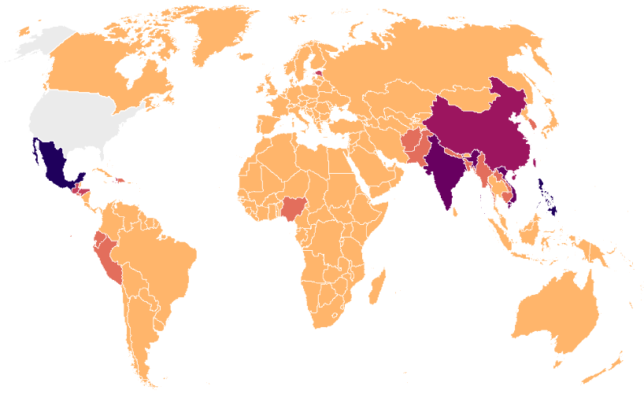

TB Cases by Countries of Birth Among Non-U.S.–Born* Persons with TB, United States, 2021 (N=5,626)
China
6%
Mexico
19%
Philippines
12%
India
10%
Vietnam
8%
N/A
0 - 49
50 - 99
100 - 249
250 - 399
400 - 599
600 +
*Persons born in the United States, certain U.S. territories, or elsewhere to at least one U.S. citizen parent are categorized as U.S.-born. All other persons are categorized as non-U.S.–born.
Notes:
In 2021, five countries of birth accounted for 54% of countries of birth origin among non-U.S.–born persons with reported TB in the United States.
The most common countries of birth among non-U.S.–born persons with TB disease remained similar to previous years, with Mexico (18.7%) as the most frequently reported country of birth, followed by the Philippines (12.3%), India (10.2%), Vietnam (7.5%), and China (5.6%). These countries of birth also have large populations that live in the United States.

Slide 13
TB Cases by Age Group, United States, 1993–2021
Notes:
The distribution of TB cases by age group in 2021 remained similar to past years with most cases occurring among persons aged 45 to 64 years (30.6%), followed closely by persons aged 25 to 44 years (28.7%) and persons 65 years or older (28.1%). In contrast, only 12.6% of reported TB cases occurred among children and young adults less than 25 years.

Slide 14

Statewide
Photo by Rebecca Wang, Lands End

Slide 15
TB in 2022 increased but stayed below prepandemic level
California 2019-2022
406 fewer
-19%
4.3 / 100K
44 more
+2.6%
4.5 / 100K
93 more
+5.3%
4.7 / 100K

Slide 16
TB in 2022 stayed below prepandemic level
Largest case increase since 1992
+109
+93

Slide 17
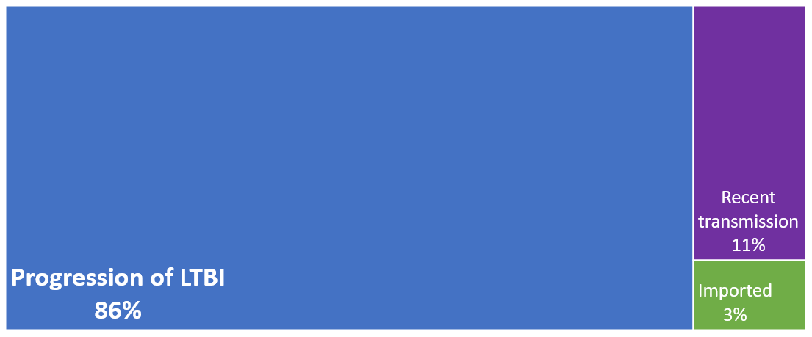
Large majority of TB attributable to progression from LTBI
California 2021

Slide 18
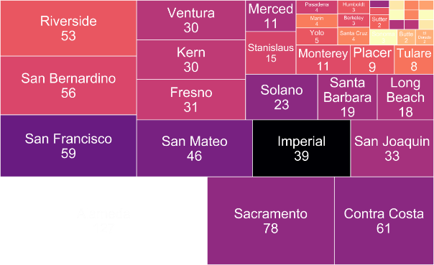




Absolute burden (case number) by jurisdiction, colored by incidence rate
Darker colors = higher rates

Slide 19
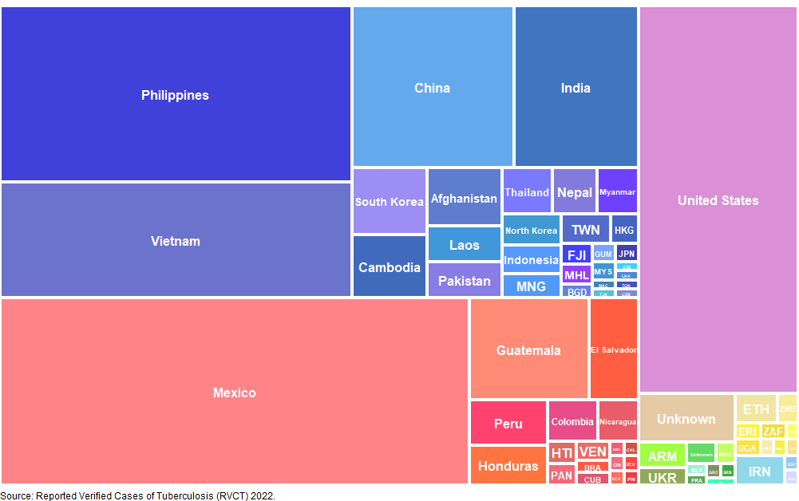
People with TB in California come from all over the world
Country of birth for people with TB in California, 2022
83% born outside U.S.
7%
5%
16%
10%
17%
23%

Slide 20
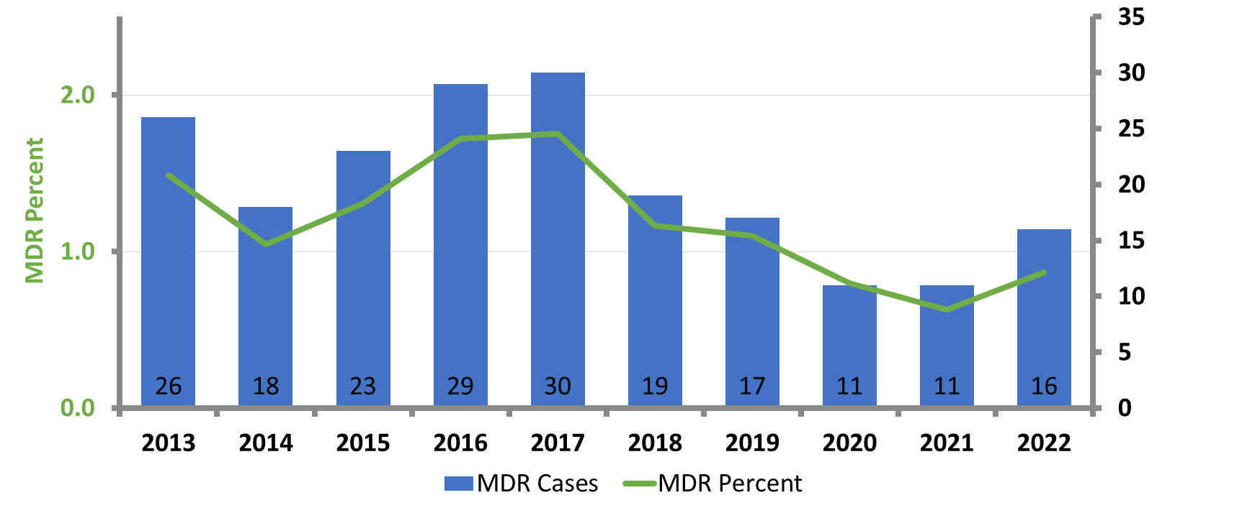
MDR remains ~1% of TB
Primary Multidrug-resistant TB Cases California, 2013‒2022
MDR = Resistance to both isoniazid and rifampin

Slide 21
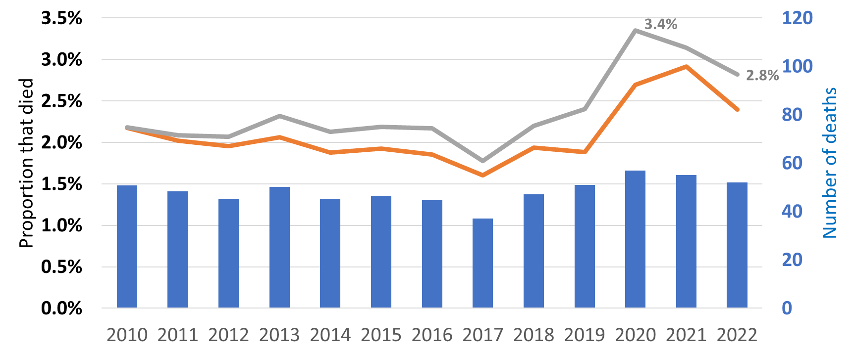
Proportion of people with TB who died before treatment start increased during COVID
Crude
Age adjusted
Notes:
2018 47
2019 51
2020 57
2021 55
2022 52

Slide 22

Tuberculosis in Sonoma County
5-year report (2018-2022)
March 23, 2023
Julia Rubin
Epidemiologist

Slide 23
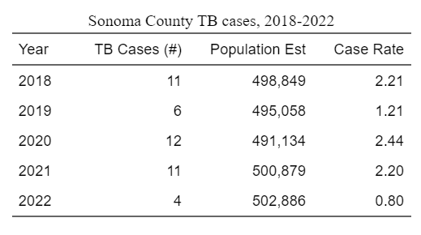
Decrease in active TB cases in 2022
In between 2018 and 2022, an average of 9 cases of active tuberculosis (TB) were diagnosed per year (range 4-12) for a total of 44 cases within the 5-year period.
In 2022, the rate of TB in Sonoma County was 0.8 cases per 100,000, comparatively lower than previous years
Target Case rate for CA for 2022 is 4.2
Notes:
https://www.cdph.ca.gov/Programs/CID/DCDC/CDPH%20Document%20Library/TBCB-CA-Objectives-Targets-2020-2024.pdf
CDPH Targets
**note data comes from CalREDIE records, could be missing or incomplete, miscoded

Slide 24
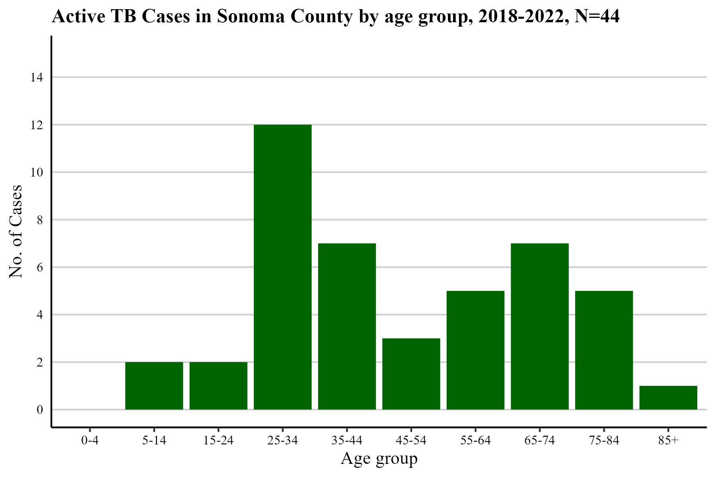
25-34 age group most impacted by TB
Notes:
Between 2018 and 2022, the age group most affected by TB infection in Sonoma County was 25-34 years of age (12, 27%)
Because the absolute number of cases is small, it is difficult to evaluate changing trends in age groups among Sonoma County cases.
Majority of cases age 55+, no cases under 5 (most vulnerable outcomes)

Slide 25
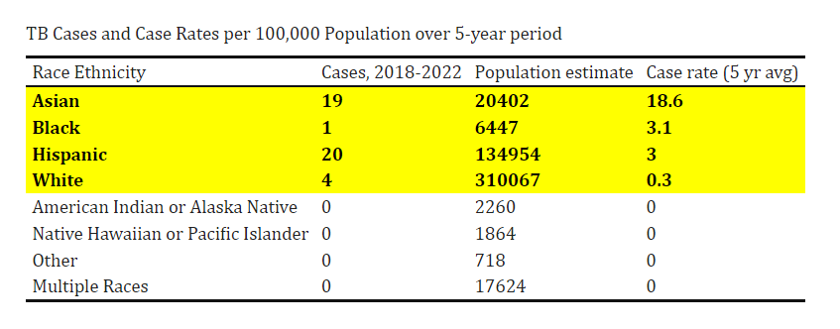
Higher rates among Asian, African American, Latinx groups compared to White
Notes:
Among TB cases diagnosed in the past 5 years, persons who are Asian (18.6 cases per 100,000), Black or African American (3.1 per 100,000) or report Hispanic/Latino ethnicity (3 cases per 100,000) report a higher rate of disease compared to Whites (0.3 cases per 100,000).
Because the latinx and white population make up a comparatively larger percentage of the population (63, 27 respectively) compared to Asian and black pop (4 and 1 pct), we have the differences in case rates
CA provisional data tables, table 3:
https://www.cdph.ca.gov/Programs/CID/DCDC/Pages/TB-Disease-Data.aspx
4 cases with unknown race/ethnicity

Slide 26
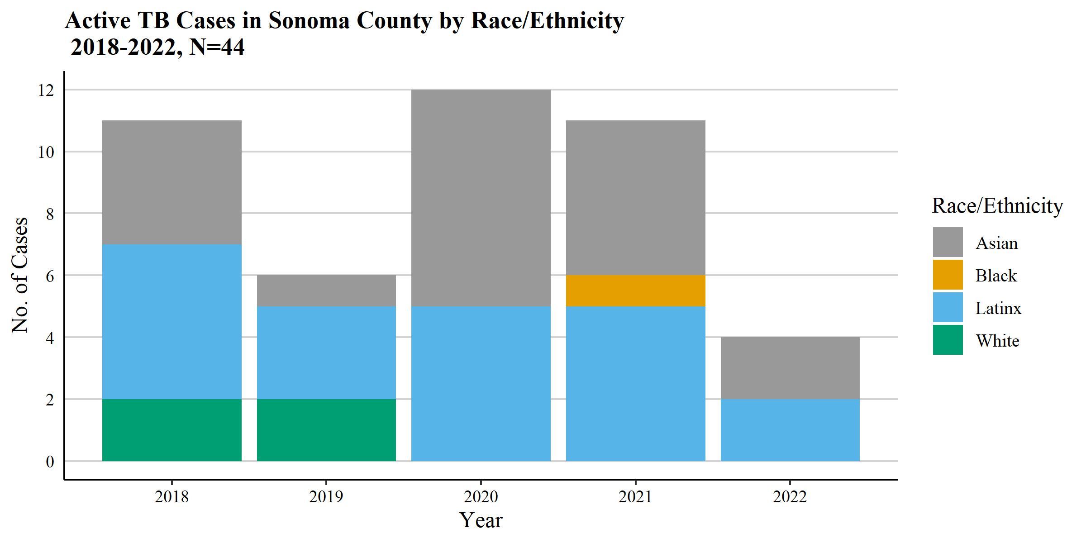
Asian, Latinx makes up majority of TB cases in Sonoma County over the past 5 years
Notes:
Over the past 5 years, 1 case black AA, 4 white cases, the majority of our cases being of Hispanic or Asian, NH race/eth groups

Slide 27
Cases by Birth Country
Over the past 5 years, 91% of Sonoma County’s TB cases were diagnosed among foreign-born individuals. Of these cases reporting a non-US birth country
  14 (32%) were from Mexico
  5 (11%) were from Nepal
  4 (9%) from Vietnam
  2 each from China, El Salvador, India, Philippines
  9 from other countries (4 Asia, 3 from Central/South America, 1 Europe, 1 Caribbean)
  4 (9%) from the United States
Notes:
Higher percentage of foreign born compared to CA overall (91 vs 83%)

Slide 28
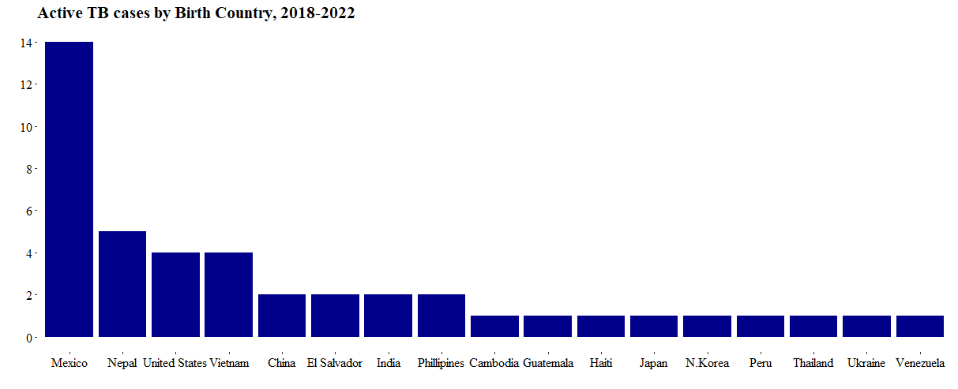
Majority of cases 2018-2022 from Mexico

Slide 29
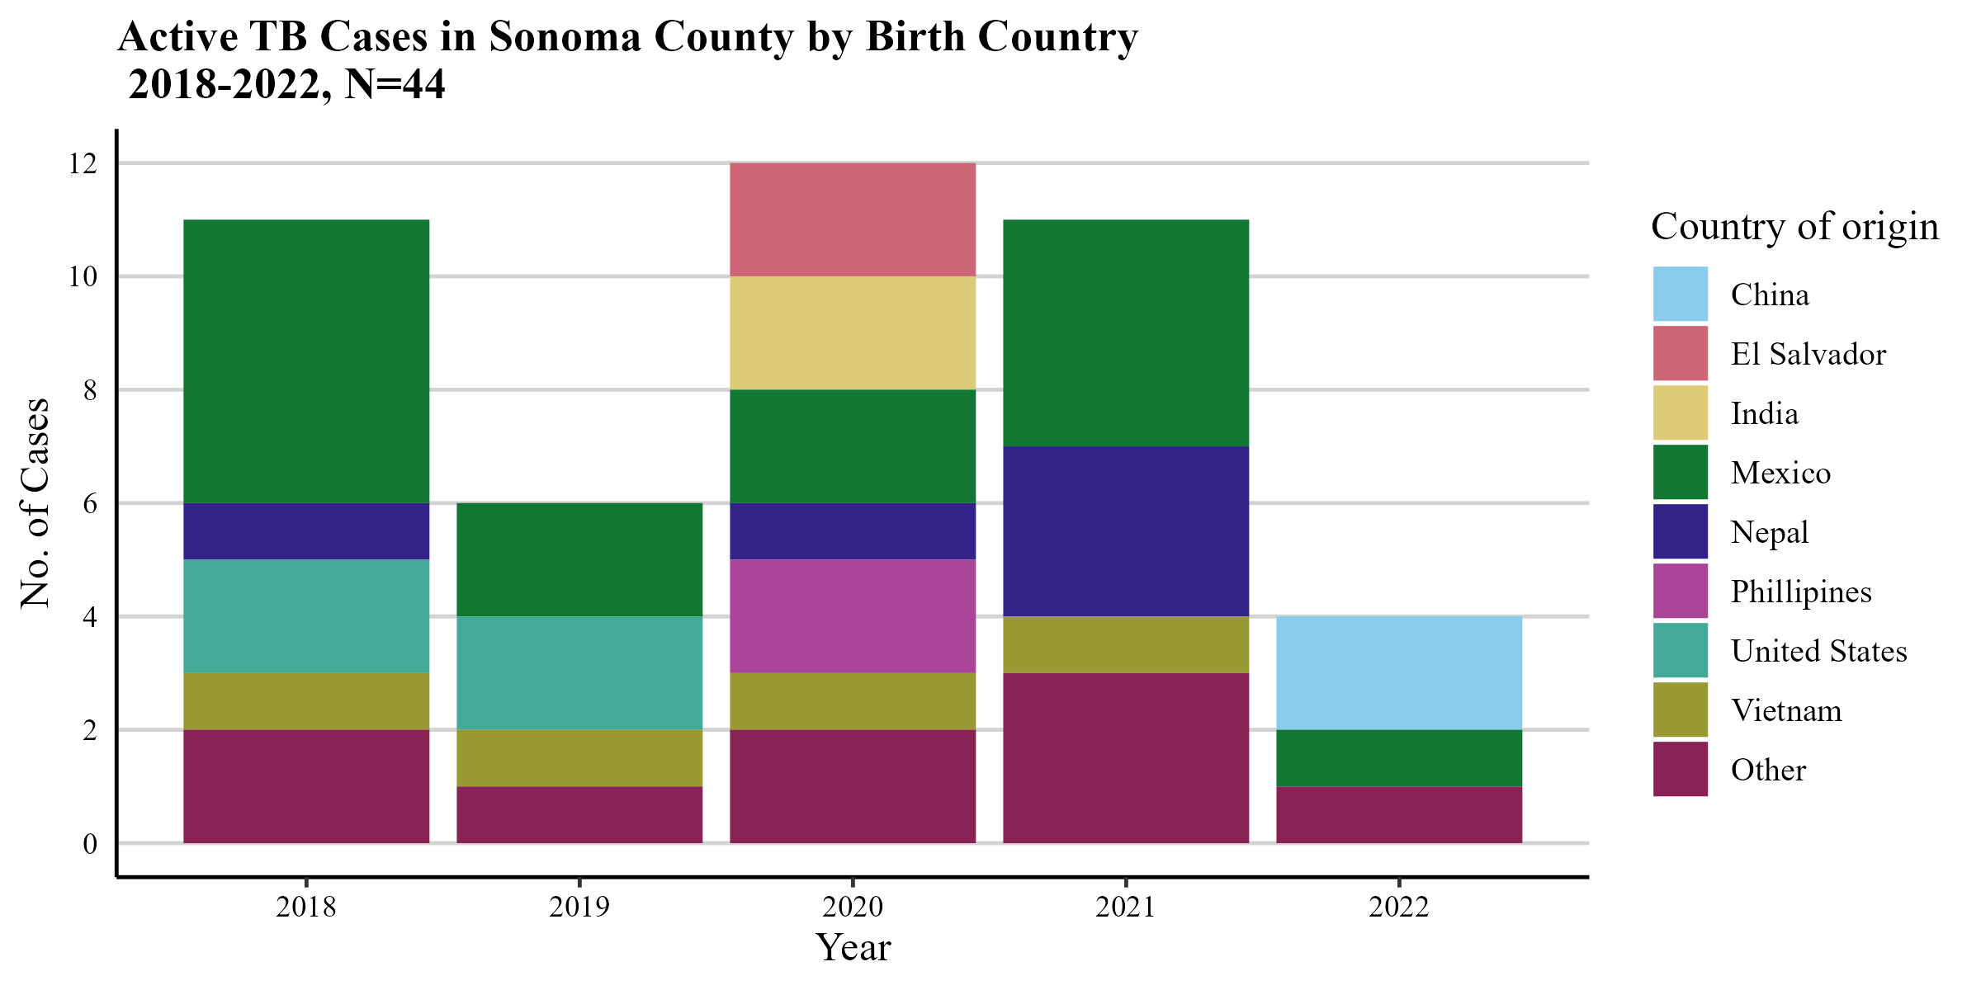
Notes:
Mexico, Nepal, Vietnam, 2022 had 2 cases from China which is new

Slide 30
Majority of TB testing done at SCPHL
Notes:
Other includes clinical labs (hosp) including one out of county/state
*send samples to our PHL, fastest turnaround time

Slide 31
Primary reason evaluated for TB
Reason Evaluated for TB | Cases
TB Symptoms | 19
Abnormal CXR | 9
Incidental lab result | 9
Contact investigation | 3
Immigration medical exam | 1
Unknown | 3
Notes:
An incident lab result means that a clinical evaluation was for something other than TB (e.g., bronchoscopy or autopsy). Specimens were collected and submitted for evaluation of TB and other diseases for diagnostic completeness. TB was not suspected at the time test was ordered.

Slide 32
Testing
 | IGRA | Skin Test
Positive | 24 | 3
Negative | 6 | -
Unknown | 4 | 14
Not done | 10 | 27
Notes:
Majority (27/44) had positive IGRA or skin test,
In SC, moving away from skin test and towards IGRA, a better test

Slide 33
Chest Radiography/Imaging Results
Result | CXR | CT Scan
Normal | 11 | 3
Abnormal (consistent with TB) | 28 | 26
Not done | 5 | 15
Notes:
Check on not done
3 pulmonary – why not done?
2 extrapulmonary

Slide 34
Site of TB disease
TB Site | Count (%)
Pulmonary | 28 (64)
Pulmonary only | 28
Extrapulmonary | 11 (25)
Brain | 2
Colon | 1
Eye/ear | 2
Genitourinary | 1
Lymph | 3
Other, not stated | 2
Pulmonary + other | 5 (11)
Pulmonary + bone | 1
Pulmonary + bone marrow | 1
Pulmonary + lymph | 1
Pulmonary + pleural | 1
Pulmonary + small intestines (duodenum) | 1
Notes:
What are the other not stated extrapulm sites?
*other - 1 is abdominal fluid

Slide 35
Test results by TB site
33 positive culture samples
 | Pulmonary |  | Pulmonary + other |  | Extrapulmonary |  | Total
 | smear + | smear - | smear + | smear - | smear + | smear -
Culture (+) | 11 | 10 | 5 | - | 1 | 6 | 33
Culture (-) | 1 | 5 | - | - | 1 | 3 | 10
Notes:
Smear pos, culture neg
Info on the one with no culture- what happened?
Culture negative- were they provider or clinical dx?

Slide 36
Culture negative diagnoses verification
 | Pulmonary |  | Pulmonary + other |  | Extrapulmonary |  | Total
 | smear + | smear - | smear + | smear - | smear + | smear -
Culture (-) | 1 | 5 | - | - | 1 | 3 | 10
Verification | Positive NAA (1) | Clinical case defn (5) |  |  | Verified by provider (1) | Verified by provider (2) Clinical Case Defn (1)
Notes:
Unclear why cult neg smear + pulmonary all I know is that this person died

Slide 37
Susceptibility Testing- PZA, INH resistance seen, majority pansusceptible
Susceptibility testing was performed on 33 of 44 specimens since 2018
9 (27%) of 33 specimens showed resistance to one drug
  5 (15%) of these 33 specimens showed resistance to Pyrazinamide (PZA)
  4 (12%) of the 33 specimens showed resistance to Isoniazid (INH)
  Susceptible to all other drugs
24 (73%) pansusceptible
  All samples susceptible to all other drugs tested including Rifampin, Ethambutol, Amikacin, Capreomycin, Moxifloxacin
No specimens treated at MDR
Notes:
For those tested against second line drugs, no resistance seen

Slide 38
Risk factors reported among active TB cases
Risk Factor | # cases (%)
Diabetes | 6 (13.6%)
Immunosuppressed (not HIV/AIDS) | 4 (9.1%)
Excessive alcohol consumption (past year) | 4 (9.1%)
Contact to Infectious TB contact | 3 (6.8%)
Homeless | 2 (4.5%)
Incomplete LTBI tx | 2 (4.5%)
End stage renal disease | 2 (4.5%)
HIV positive status | 2 (4.5%)
Non-injection drug use | 2 (4.5%)
Occupational migrant | 1 (2.3%)
Smoking | 1 (2.3%)
Missed contact | 1 (2.3%)
LTCF Resident – Nursing Home | 1 (2.3%)
Correctional facility resident | 1 (2.3%)
Notes:
Not mutually exclusive, people can have more than 1 risk factor

Slide 39
TB deaths 2018-2022
3 Fatalities among TB patients
2 died of reasons related to TB (2020, 2021)
  Age category 65-74; 75-84
Third died of COVID (2021)
Notes:
Cause of death for third patient

Slide 40
Contact investigations
~5-15 contacts investigated from newly discovered TB patients
2021 case worked at restaurant, 48 contacts investigated
2021, another restaurant outbreak with HH contacts, CI conducted at multiple restaurants, ~35 contacts, 2 additional cases identified
2019 case, 31 contacts identified at church
2019 outbreak at a homeless shelter, 1 additional case identified
5 cases epi linked to at least 1 other case
Notes:
How many worksite investigations?
How many contacts were identified?
3-4 counties involved n that outbreak, 3(?) cases uncovered, penticostal church

Slide 41
Questions?

Slide 42



Slide 43
Latent TB Infection
Diagnosis and Treatment

Slide 44
What is Tuberculosis?
Tuberculosis (TB) is an infection caused by a type of bacteria (germ) called Mycobacterium tuberculosis
3 tuberculous mycobacteria – M. tuberculosis, M. bovis, M. africanum
Other nontuberculous mycobacteria

Slide 45
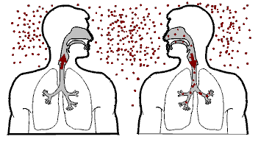
TB Transmission
Person with active pulmonary TB exhales TB bacilli in “droplet nuclei”
Droplet nuclei are inhaled by person sharing the same airspace
Infection begins when droplet nuclei reach the alveoli
Small number enter the bloodstream and spread throughout the body.

Slide 46
Does everyone who is exposed to TB become infected and get sick?
Approximately 70% of exposed people will NOT become infected.
Approximately 30% of exposed people will become infected.
  5% of infected people will develop TB disease within 1-2 years of infection.
  95% will contain the infection
    5% will get disease later in life
    90% will never develop disease.

Slide 47
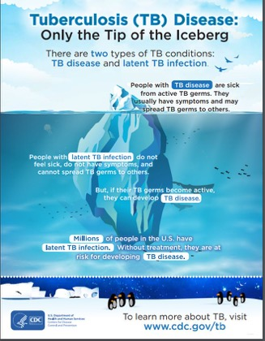

Slide 48
Latent TB Infection (LTBI)
Active TB Disease
Small amount of inactive tubercle bacilli in the body
Tuberculin skin test or interferon-gamma release assay (IGRA) test results usually positive
Chest x-ray usually normal
Sputum smears and cultures negative
No symptoms
Not infectious
Not a case of TB
Large number of active tubercle bacilli in the body
Tuberculin skin test or interferon-gamma release assay (IGRA) test results usually positive
Chest x-ray may be abnormal
Sputum smears and cultures may be positive
May feel sick/symptoms such as cough, fever, weight loss
May be infectious before treatment
A case of TB
Source: Adapted from: CDC. Transmission and Pathogenesis of Tuberculosis. Self-Study Modules on TB. US DHHS. Atlanta, GA; 2019:18.

Slide 49
Persons at Risk for Developing TB Disease
increased likelihood of exposure to persons with TB disease
clinical conditions that increase their risk of progressing from LTBI to TB disease

Slide 50
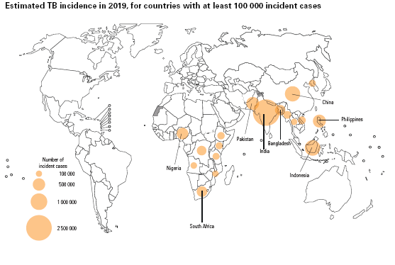
TB Exposure Risks
Persons at risk for exposure to persons with TB disease include:
Close contacts to person with infectious TB
Persons who have immigrated from areas of the world with high rates of TB
Persons who work or reside with people who are at high risk for TB in facilities or institutions such as hospitals, homeless shelters, correctional facilities, nursing homes, and residential homes for those with HIV
Source: WHO Global TB Report 2020 https://apps.who.int/iris/bitstream/handle/10665/336069/9789240013131-eng.pdf
Notes:
Highlights from the 2017 U.S. TB Surveillance Report: Up to 13 million people in the United States have latent TB infection.

Slide 51
Risk for Progression to Disease after infection
Persons who have been Recently Infected with TB Bacteria
Persons with Medical Conditions that Weaken the Immune System
Children less than 5 years of age who have a positive TB test
Groups with high rates of TB transmission, such as homeless persons, injection drug users, and persons with HIV infection
Recent converters (first 2 years after conversion)
Babies and young children often have weak immune systems.
HIV infection
Substance abuse
Silicosis
Diabetes mellitus
Severe kidney disease
Low body weight
Organ transplants
Head and neck cancer
Medical treatments such as corticosteroids or organ transplant
Specialized treatment such as TNF-α antagonists for rheumatoid arthritis or Crohn’s disease
Notes:
Several studies show that those that convert TST or IGRA testing have the highest change of progression in the first 2 years of that conversion. Likewise, recent immigrants (less than 5 years) from high burden countries have the highest risk of progressing disease in the first 2 years of arrival

Slide 52
TB Pathogenesis
Progression to TB disease
TB infection
No risk factors
TB infection
and diabetes
TB infection
And HIV
TB
Disease
(10% over
a lifetime)
TB
Disease
(30% over
a lifetime)
TB
Disease
(7-10% per
year.)
TB infection
(no TB disease)
TB infection
(no TB disease)
TB infection
(no TB disease)

Slide 53
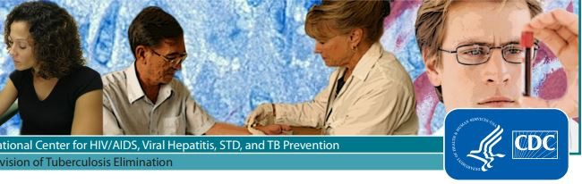
Testing for TBI

Slide 54
TB Skin Test (TST)
Advantages
Disadvantages
Easy to perform
Low cost
Observation (reading) reflects an immune response
Foundation of well controlled studies
Well established definitions of TST conversion
Trained person to place and interpret test
Variability in interpretation, reading may be subjective
2 visits necessary
Need 2 tests for baseline for serial testing
False positives/negative
Notes:
Disadvantages Need trained person to place and interpret test
Inter- and intra-reader variability in interpretation
2 visits necessary
Need 2 tests for baseline for serial testing
False positives (i.e. BCG and NTMs; incorrect reading or interpretation)
False negatives (i.e. overwhelming disease, poor administration)
Nontuberculous mycobacteria
Anergy – (inability to react to a TST because of a weakened immune system)
Recent TB infection (2 to 10 <6-8 weeks after exposure) or remote infection
Very young age – newborns
Recent viral vaccination or viral/bacterial infection
Immunosuppressive conditions or treatment

Slide 55
IGRA
Advantages
Disadvantages
BCG-vaccinated population
Screening hard to reach populations
  One patient visit
2-step testing not required
Results can be available in 24 hours
Requires blood draw
Requires access to lab
Indeterminate rate may be higher in practice than in studies
Errors in collecting and transporting blood, or in interpreting assays can decrease accuracy of IGRAs

Slide 56
Recommendations for TBI testing
ATS/IDSA/CDC Clinical Practice Guidelines: Diagnosis of TB in Adults and Children
Recommend IGRA rather than TST in > 5 years who
  Are likely to be infected with mycobacterium tuberculosis
  Have a low or intermediate risk of disease progression
  LTBI testing is warranted (risk assessment)
  Have a history of BCG vaccination
  Or are unlikely to return for TST read
TST is acceptable alternative when limitations exist
  IGRA not available, too costly, too burdensome
Recommend TST or IGRA in likely infected, high risk of progression.

Slide 57
Recommendations for TBI testing
Recommend that persons at low risk for TB infection and disease progression NOT be tested for TB infection.
  Suggest IGRA instead of TST
    TST acceptable when limitations exist for performing IGRA
  Suggest second test (TST or IGRA) if initial test is positive
Healthy children < 5 years old TST over IGRA
  Yield to IGRA preference if BCG vaccinated

Slide 58
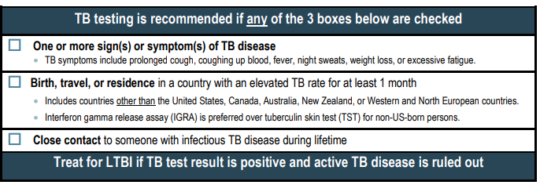
Who to test
CA Adult TB Risk Assessment

Slide 59
Treating TBI

Slide 60
What is always necessary before starting LTBI treatment?
Ruling out active TB!
For patients with TB symptoms or an abnormal chest x-ray, evaluate for active TB disease with a chest x-ray, symptom screen, and if indicated, sputum AFB smears, cultures, and nucleic acid amplification testing. A negative tuberculin skin test or interferon gamma release assay does not rule out active TB disease.

Slide 61
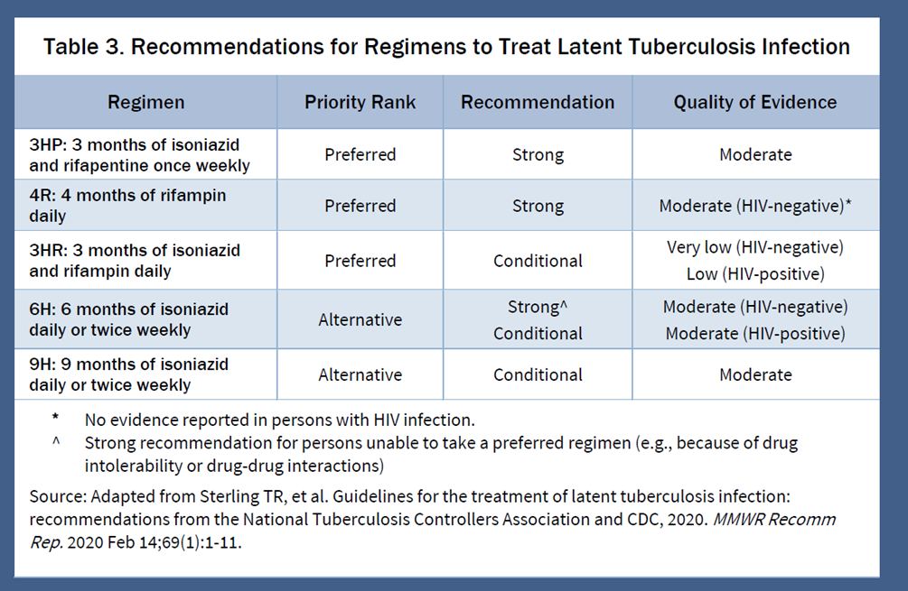

Slide 62
Add B6 with regimens including Isoniazid
If the patient has:
- Diabetes
- Chronic Kidney Disease
- Heavy ETOH use
- Malnutrition
- HIV infection
- Pregnant or post-partum
- Seizure disorder
Then, add B6:
- Adult Dosing:
25-50mg if given daily
100mg if given once weekly

Slide 63
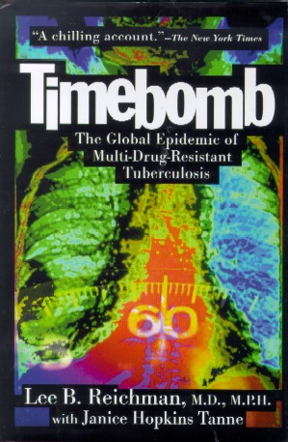
TB Disease
Diagnosis and Management

Slide 64
Why Do We Care about TB?
TB has been with humans for a long time; archeologists found TB in the spine of a mummy from 4000 BC
Until COVID-19, TB was the #1 infectious disease killer in the world
  13th leading cause of all causes of death worldwide
  causes 1.5 million deaths per year worldwide
One-fourth of the world’s population is infected with TB (silently)
TB is airborne and can be spread from person to person
Drug-resistant TB is much harder to treat, so early diagnosis and appropriate treatment of susceptible TB is important
https://www.cdc.gov/tb/worldtbday/history
https://www.who.int/news-room/fact-sheets/detail/tuberculosis

Slide 65
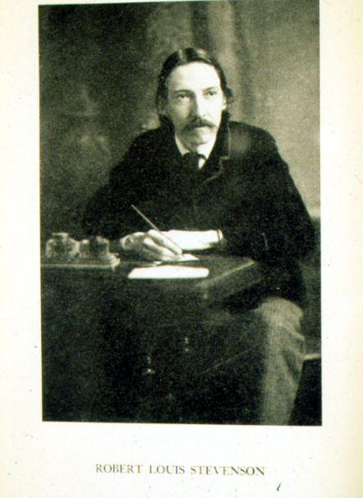



Fame, Infamy, and TB
Tutankhamen*, Richelieu*, Moliere
Spinoza*, Voltaire, Goethe
Schiller, Sir W. Scott, Simon Bolivar*
Paganini, Keats*, Emerson, Browning*
Poe*, Chopin*, Bronte*, Dostoyevski, Gaugin
RL Stevenson*, Chehkov*, Kafka, E. Roosevelt*
DH Lawrence*, Hitler, Orwell*, Vivian Leigh*
Mandela, Cat Stevens, Tom Jones

Slide 66
Importance of Diagnosing TB
Fundamental for:
the best care of the patient, and
for protecting the patient’s family, workplace, social community, and
for protecting the greater public’s health

Slide 67
General Issues
Rapid, accurate diagnosis is essential for individual and public health
Definitive diagnosis requires isolation of M. tb or identification of specific DNA
  Treatment may be appropriate even in the absence of definitive diagnosis
Diagnosis depends on clinical suspicion and appropriate evaluation

Slide 68
General Issues:
Clinical Suspicion
To diagnose TB, you must first think of TB
Knowing when to consider TB in the differential diagnosis = knowing who is at risk
  Risk for infection
  Risk for disease

Slide 69
Clinical Presentation
REMEMBER!
TB can involve any organ or tissue
Symptoms and severity range from none to overwhelming
Tempo of illness ranges from indolent to fast
Symptoms/findings may be both local and systemic
Presentation is often atypical in the immunocompromised (i.e. HIV, DM)

Slide 70
Clinical Presentation
Symptoms and Signs
Pulmonary
  Cough – 40-80%
  Sputum production
  Pleuritic chest pain
  Hemoptysis
Systemic
  Fever – 65-80%
  No symptoms – 10-20%
  Chills/sweats
  Fatigue/malaise
  Anorexia/weight loss
Notes:
Hemoptysis is often a complication of previous TB. Not always a sign of active disease

Slide 71
Pulmonary TB:
Radiographic Presentation
FINDING | Primary (child, HIV, DM, recent converter) | Post-primary (reactivation)
Opacity | Upper:Lower 60:40 | 85% upper
Cavitation | Rare | Often present
Adenopathy | Adults – 30% Children -common | Rare
Effusion | May be present | May be present

Slide 72
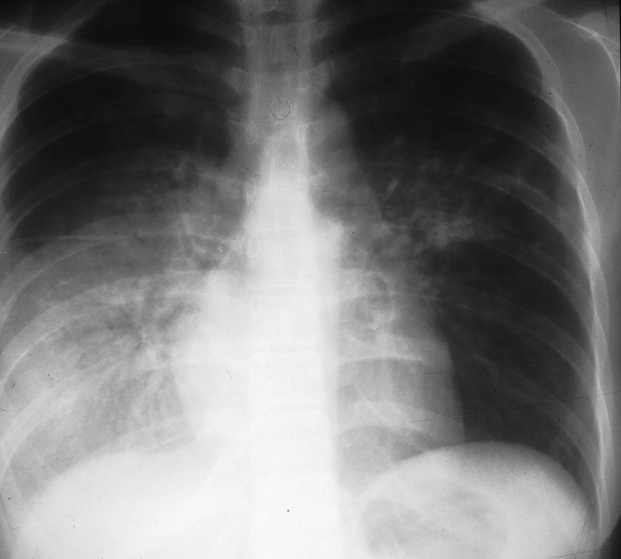
Primary TB

Slide 73
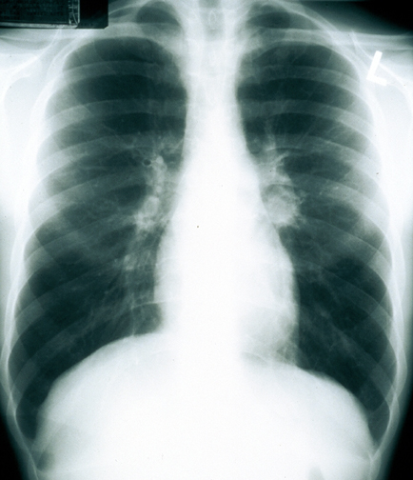
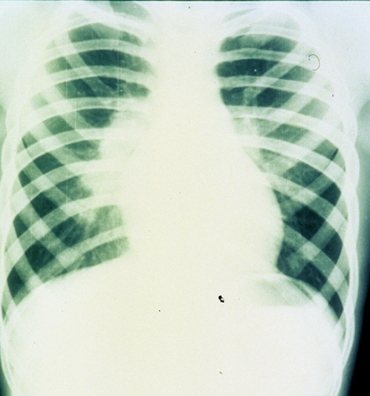
Primary TB (2)

Slide 74
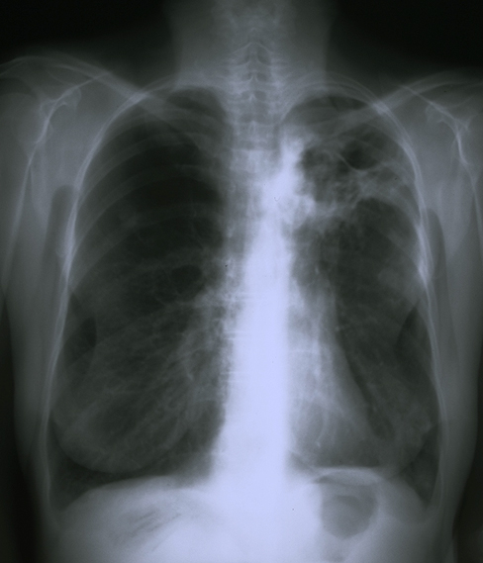
Reactivation TB
Apical Infiltrates
Cavitation
Scarring and volume loss

Slide 75
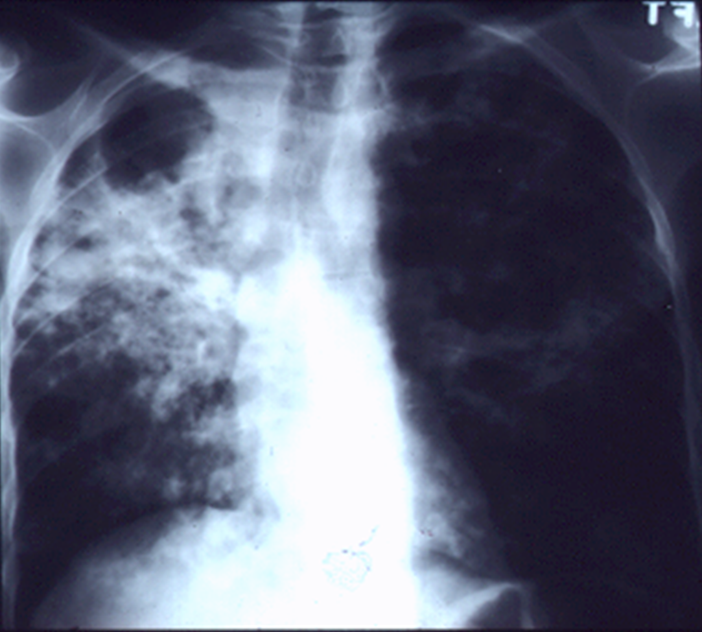
Post-primary TB (Reactivation) (2)

Slide 76
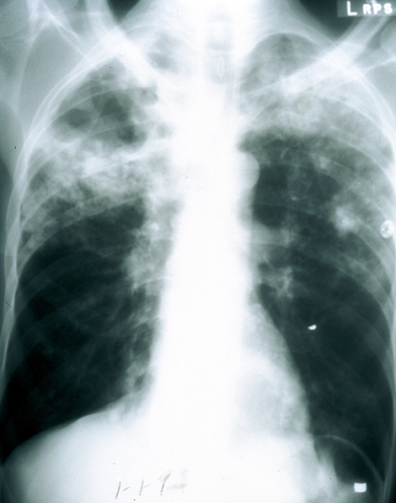
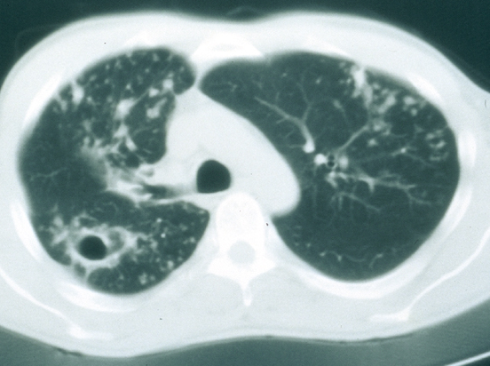
Reactivation
TB (3)
Apical Cavitary Disease
Cavity and Nodular Infiltrates From Endobronchial Spread

Slide 77
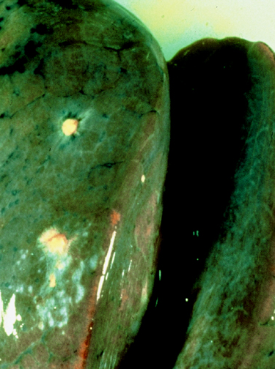
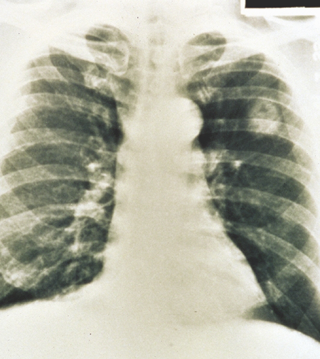
Tuberculoma

Slide 78
Extrapulmonary TB

Slide 79
Percentage of TB Cases by Site of Disease,* United States, 2021
*Patients may have more than one disease site but are counted in mutually exclusive categories for surveillance purposes.
†Any pulmonary involvement which includes cases that are pulmonary only and both pulmonary and extrapulmonary.
Notes:
The vast majority of TB cases had pulmonary involvement (78.8%). Among the 21.2% of TB cases with only extrapulmonary involvement, TB of the lymphatic system remained most common (30.6%), followed by TB of the pleura (15.2%). Bone and joint TB increased from 143 (8.9%) cases in 2020 to 243 (13.7%) cases in 2021, including 113 cases associated with a large outbreak linked to a bone allograft product.
TB meningitis, a particularly serious form of the disease involving the meninges, made up 3.5% of extrapulmonary only cases. “Other” includes all other extrapulmonary sites of disease (e.g., ocular, hepatic).

Slide 80
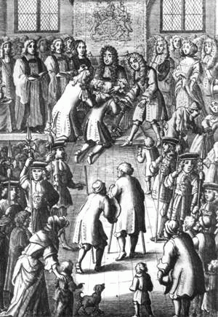
Notes:
2400 BC – TB in spine of Egyptian mummies
Charles II of England touching for scrofula
Tuberculosis is a disease we have battled for a very long time (long and interesting history);

Slide 81
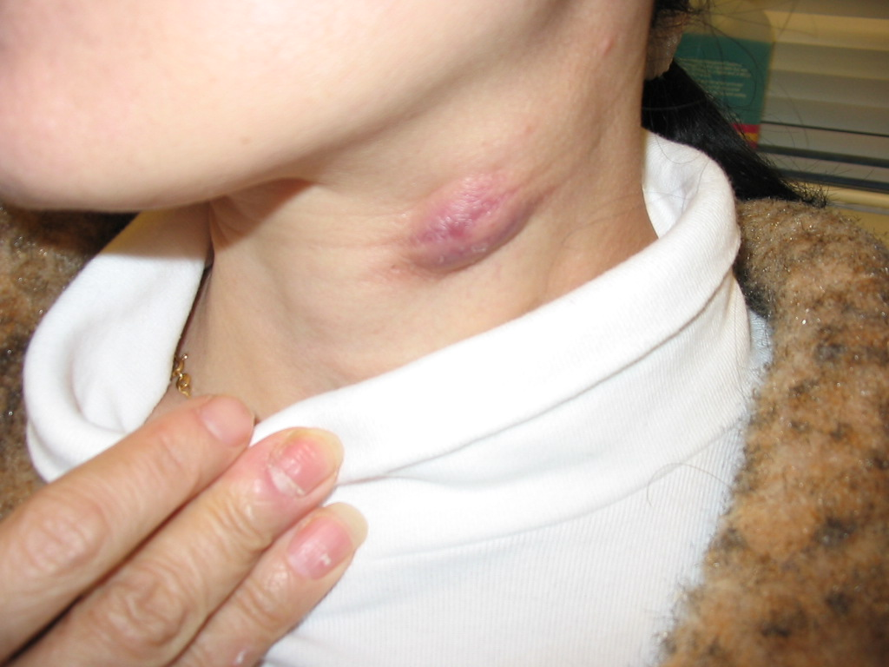
TB Lymphadenitis
Usually, painless swelling of the lymph nodes
Most often involves the cervical and supraclavicular sites (scrofula)
Usually discrete in early stage, but may become inflamed and develop a fistulous tract

Slide 82
TB Lymphadenitis (2)
Lymphadenitis is a usually a “paucibacillary” form of TB
Fine needle aspiration:
  Smear positive 40%, culture 60-65%
  PCR sensitivity >90%
Excisional biopsy:
  Culture positive 70-75%, granulomas 85-90%
  Excision without TB Rx → 83% relapse rate

Slide 83
TB Pleurisy
Clinical Manifestations
Acute illness (pleuritic CP, cough, fever) often mistaken for bacterial pneumonia or pleurisy
Usually 6-12 weeks after primary TB infection but can occur during reactivation
Pleural effusion usually unilateral and small or moderate in size
Parenchymal lung involvement evident in 1/3

Slide 84
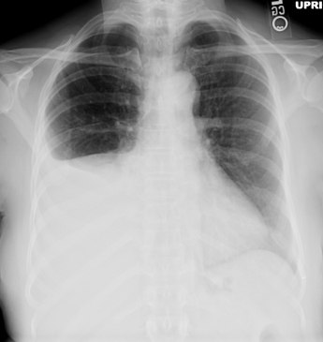
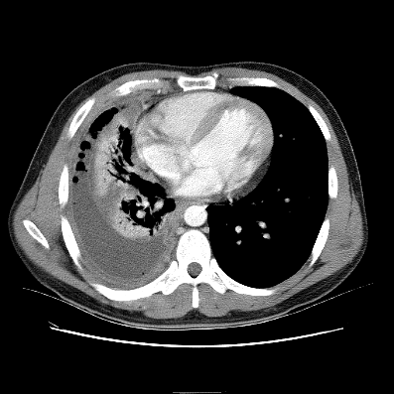
Pleural TB
The sequel to a primary infection 6 to 12 weeks previously
Or, reactivation TB

Slide 85
Disseminated (Miliary) TB
Either primary or post-primary
Symptoms: primarily systemic (fever, weight loss, night sweats)
Multiple organ involvement
Miliary chest x-ray (CXR) pattern
Pathology: grossly, 1-2 mm yellowish nodules that resemble millet seeds (histologically, granulomas)

Slide 86
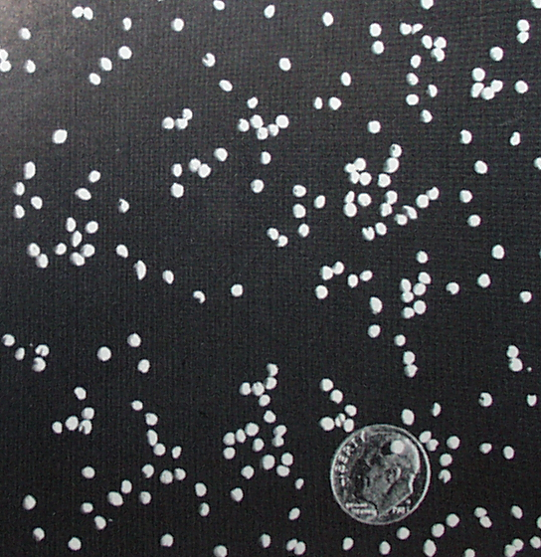
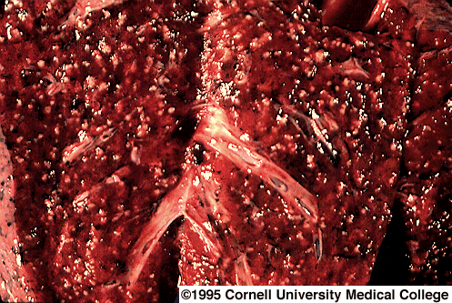
Miliary TB
Millet Seeds

Slide 87
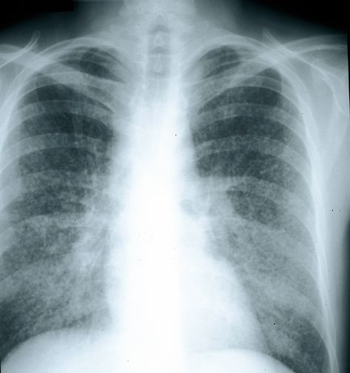
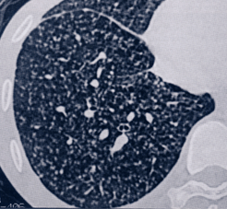
Miliary TB (2)

Slide 88
Diagnosis of
Disseminated TB
Sputum (positive smear 30%, culture 60%)
Morning urine (positive culture 30%)
Biopsy and culture of new skin lesions or superficial lymph nodes
Lumbar puncture if (+) meningeal signs
Consider bronchoscopy, liver biopsy, bone marrow biopsy

Slide 89
Approach to the Patient with Suspected TB

Slide 90
Maintaining a High Index of Clinical Suspicion
If a patient has risk factors for TB…
And, they have a clinical illness, exam finding, and/or radiographic image compatible with TB…
Then, they may have active TB, and they should be evaluated for TB disease

Slide 91
Diagnosis of TB Disease
TB is a clinical, radiographic, and (usually) laboratory diagnosis
Suitable laboratory specimens
  Sputum or bronchoscopic sample
  Gastric aspirate
  Pleural fluid, stool, urine, csf, other
  Tissue (lung, pleura, lymph node, other)

Slide 92
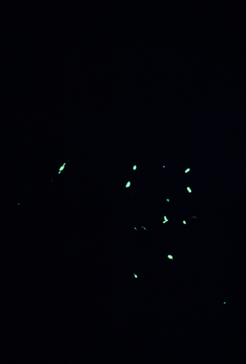
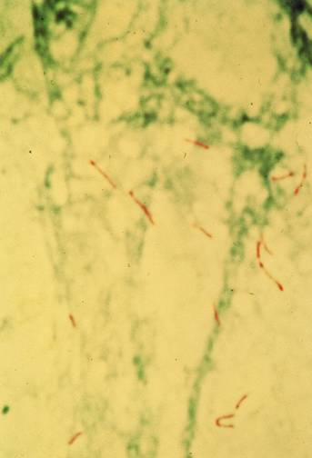
When there is a High Index of Suspicion for TB…
Obtain a chest radiograph
Perform sputum examination (AFB smear, NAAT and culture)
Evaluate any non-pulmonary symptoms and signs
Auramine
AFB

Slide 93
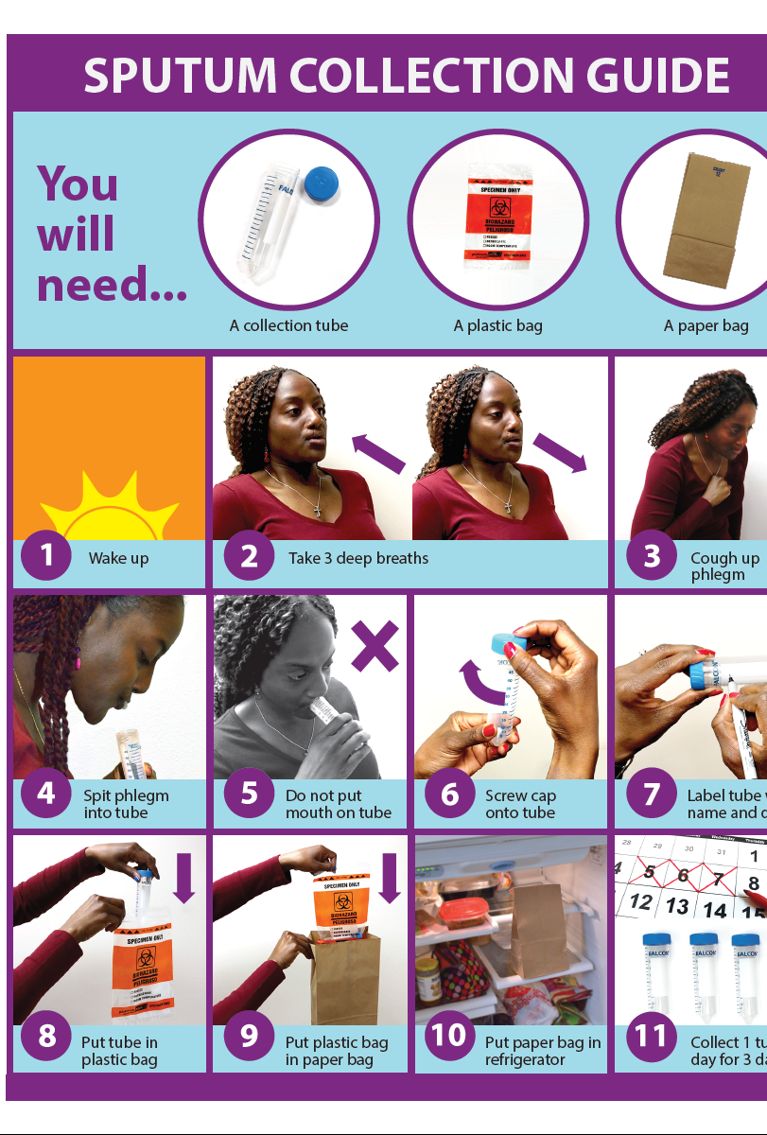
Sputum Examination
AFB Smears
  Ziehl-Nielsen, auramine-rhodamine
  Rapid, ~50-70% sensitive, nonspecific (NTM)
Culture
  Sensitive and specific, but slow
  Beware “culture negative” TB
Molecular methods
  Nucleic Acid Amplification Test/PCR

Slide 94
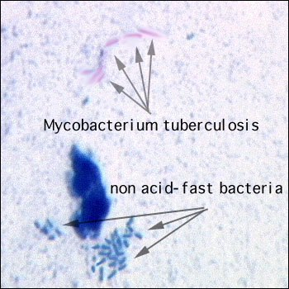
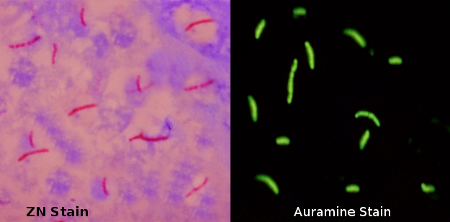

Sputum SMEARs - results
Negative result- the NAAT or culture may still be MTB+!
Positive result- patient may have MTB BUT…can be nontuberculosis mycobacteria (NTM) IF MTB, highly infectious.
AFB smear positive – 1+- 4+
The higher the smear grade, the more infectious.

Slide 95
Nucleic acid amplification test (NAAT)
The NAAT is a molecular test
It detects genetic materials of TB (not antibodies or antigens)
CDC recommends the use of NAATs in all patients for whom a diagnosis of TB is being considered if the results would influence clinical or public health decision-making
The reality…most labs only automatically test smear+ sputum or upon request due to expense
Most labs are not validated (approved ) to test primary extrapulmonary specimens (e.g. tissue, lymph node, etc.) using NAAT. Only respiratory specimens

Slide 96
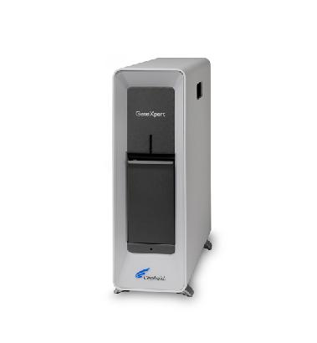
Nucleic acid amplification test (NAAT)
NAAT for MTB = TB PCR, GeneXpert MTB/RIF, MTD, other names or types
Can be run on “primary specimen” - sputum
Identify if MTB or NTM in a smear+ patient = faster release from airborne or home isolation (if NTM) or earlier start of appropriate treatment
May be used to detect MTB faster in smear- = less spread of TB disease due to earlier initiation of airborne isolation and treatment.
Results available quickly in <24 hours - 5 days after sputum submitted
Do NOT use as “test of cure” (deadbugs)
If positive, is a confirmed TB case
GeneXpert platform can be used to test for many other infectious diseases besides TB (flu, MRSA, etc.). Becoming more commonly used by hospital labs. Is a nucleic acid amplification test.
Detects MTB AND mutations associated with Rifampin resistance.
Usually if RIF resistant, also INH resistant = MDR.

Slide 97
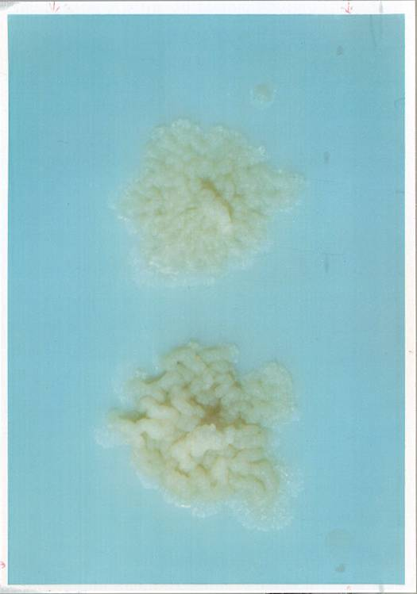
Mycobacterial Culture in the Diagnosis of TB
Culture is the “Gold Standard” test for the diagnosis of TB
Culture all specimens, even if smear negative
Up to 20% of TB cases may be culture negative
Culture results are not available immediately (2-6 weeks depending on culture techniques)
Culture permits susceptibility testing
Colonies of
M. tuberculosis
growing on solid media

Slide 98

TB Drug Susceptibility Testing
Always request drug susceptibility testing when TB is isolated
Results usually available 2-4 weeks after culture is reported positive
Drug resistance influences treatment decisions
Rapid Molecular Detection of Drug Resistance now available
Drug susceptibility testing on solid media. Upper left quadrant contains no drug.

Slide 99
Diagnosis of TB:
Summary
Think TB if “high-risk” profile
Although lungs are primary site of infection, TB can involve any organ
Positive smears correlate with contagiousness and the extent of disease, but are negative in half of all TB cases
New TB diagnostic tests can improve on the sensitivity and specificity of AFB smear results
Clinical suspicion remains key to TB diagnosis

Slide 100

Case Presentation
67 yo man, born in a TB endemic country, living in the US x 1 year
DM2
3 months of cough, fatigue, weight loss, then hemoptysis
CXR with RLL cavity
Just about to start being the caregiver for his 3 year old granddaughter
https://www.cdc.gov/tb/education/corecurr/pdf/chapter4.pdf

Slide 101

Epidemiology
What is the likelihood of TB exposure in their lifetime
resided in high burden country
involved in correctional settings
experiencing homelessness
experiencing substance abuse
https://www.who.int/publications/digital/global-tuberculosis-report-2021/tb-disease-burden/incidence#fig--2-1-1

Slide 102
Risk Factors for progression from latent to active TB
  Immunosuppresion: HIV, DM, ESRD, immunosuppressants (e.g. TNF-alpha inhibitors)
  Recent converters/recently exposed
  Children < 5 y.o.
  CXR with apical fibrosis/scarring concerning for prior untreated TB

Slide 103
Patient Environment
The threshold to start empiric TB treatment can be lowered by patient’s social environment
Healthcare worker
Congregate settings
  Shelter, nursing home, school, dialysis
Household contact to high-risk individuals
  Children < 5 y.o.
  Immunosuppressed: HIV, chemotherapy

Slide 104
Case Presentation:
67 yo man, born in a TB endemic country, living in the US x 1 year
DM2
3 months of cough, fatigue, weight loss, then hemoptysis
CXR with RLL cavity
Next steps?
Concern for TB?
Isolate?
Start treatment?
Further tests needed?

Slide 105
Case Presentation:
67 yo man, born in a TB endemic country, living in the US x 1 year
DM2
3 months of cough, fatigue, weight loss, then hemoptysis
CXR with RLL cavity
Next steps?
Concern for TB? Yes
Isolate? Yes and avoid contact with his granddaughter
Start treatment? Not just yet
Further tests needed? Yes

Slide 106
Case Presentation: Early Data Phase
67 yo man, born in a TB endemic country, living in the US x 1 year
DM2
3 months of cough, fatigue, weight loss, then hemoptysis
CXR with RLL cavity
2 days later: Smear results 4+ AFB, PCR MTB positive
Next steps
Concern for TB?
Isolate?
Start treatment?
Further tests needed:

Slide 107
Case Presentation:
67 yo man, born in a TB endemic country, living in the US x 1 year
DM2
3 months of cough, fatigue, weight loss, then hemoptysis
CXR with RLL cavity
2 days later: Smear results 4+ AFB, PCR MTB positive
Next steps
Concern for TB? Very strong
Isolate? Yes
Start treatment? Yes
Further tests needed: Yes, culture/sensitivities

Slide 108
Case Presentation:
67 yo man, born in a TB endemic country, living in the US x 1 year
DM2
3 months of cough, fatigue, weight loss, then hemoptysis
CXR with RLL cavity
Smear: 4+ AFB, PCR MTB positive
11 days later: Culture MTB positive

Slide 109
CDC Definition of a TB Case
Laboratory TB Case
  M. tuberculosis by culture or NAAT, or
  AFB smear + (if culture not obtained)
Clinical TB Case
  Positive TST or IGRA, AND
  Compatible signs/symptoms/imaging findings, AND
  Response to treatment with 2 or more TB meds, AND
  Completed TB diagnostic evaluation
Appendix B | Reported TB in the US 2019 | Data & Statistics | TB | CDC; phrasing courtesy of Dr. Narita

Slide 110
Try to capture the bacteria
Positive culture = confirmation of diagnosis and drug sensitivities
Empiric treatment for drug-resistant TB may lead to increased duration of treatment, unnecessary toxicities, and cost if the patient has drug-sensitive TB
Empiric treatment for drug-sensitive TB in the setting of drug-resistant TB may lead to progression of their TB causing increased morbidity and mortality, treatment failure, increased risk of transmission to others, and risk of worsening their drug-resistances
Lewinsohn CID 2017

Slide 111

TST/IGRA
Measures cellular immune response to TB antigen
Requires a functional immune system
Positive in ~80% of patients with active TB disease.
TST or IGRA results do not make or break the diagnosis of active TB disease.
Borrowed from Dr. Masa Narita

Slide 112

Published in 2017​

Slide 113
Conclusions
Be alert to the common signs and symptoms of pulmonary TB
Recognize that TB presents in many fashions
Use TB diagnostics and pillars to guide care at every step

Slide 114
Treating TB Disease

Slide 115

The Drugs (first-line)
Isoniazid (INH, “H”), 5 mg/kg/d
Rifampin (RIF, “R”), 10 mg/kg/d
Pyrazinamide (PZA, “Z”), 25 mg/kg/d
Ethambutol (EMB, “E”), 15-25 mg/kg/d

Slide 116
General Principles
Always treat with a multiple-drug regimen
Never add a single drug to a failing regimen
Completion of treatment is based on number of doses taken, not duration alone
Duration of therapy (or number of doses needed) is dependent on:
  drugs used
  extent of disease
  response to treatment
  Co-morbidities (e.g. HIV, immune-compromise)

Slide 117
General Principles
INH, RIF, PZA, and EMB are the basis of modern short-course (6 months) therapy
Directly observed therapy (DOT) should be considered for all patients
Patients not on DOT should receive fixed dose combination therapy
All drugs should be taken once daily. Divided and/or decreased doses are indicated only in special circumstances

Slide 118
General Principles, pan-susceptible
Initial Phase (initial 2 months of treatment)
  Prevents drug resistance until drug susceptibility testing (DST) is known
  INH and RIF resistance rates are increasing. INH resistance in California is >9% (as high as 27%)
  Unless full susceptibility is known, a fourth drug should always be added to INH, RIF, and PZA
  DOT should be considered for all patients
Initial Phase
(2 mo)
Continuation Phase
(4-7 mo)

Slide 119
General Principles, pan-susceptible
Continuation Phase (subsequent 4-7 months of treatment)
  Always check drug susceptibility results
  If fully susceptible:
    INH 300 mg oral dose every day (po q) PLUS
    RIF 600 mg po q day
  OR
    INH 900 mg oral dose bi-weekly (po biw) PLUS
    RIF 600 mg po biw
    (Use Rifamate whenever possible)
DOT for everyone on intermittent therapy
Initial Phase
(2 mo)
Continuation Phase
(4-7 mo)

Slide 120

Treatment Guidelines, 2016

Slide 121

Treatment Regimens

Slide 122
Drug Regimens for Drug-Susceptible TB Disease
Regimen | INTENSIVE PHASE |  | CONTINUATION PHASE |  | Range of total doses | Comments^{3, 4} | Regimen effectiveness
 | Drugs¹ | Interval and Dose² (Minimum Duration) | Drug | Interval and Dose^{2,3} (Minimum Duration)
1 | INH RIF PZA EMB | 7 days/week for 56 doses (8 weeks) OR 5 days/week for 40 doses (8 weeks) | INH RIF | 7 days/week for 126 doses (18 weeks), OR 5 days/week for 90 doses (18 weeks) | 182 to 130 | This is the preferred regimen for patients with newly diagnosed pulmonary tuberculosis. | Greater Lesser
2 | INH RIF PZA EMB | 7 days/week for 56 doses (8 weeks) OR 5 days/week for 40 doses (8 weeks) | INH RIF | 3 times weekly for 54 doses (18 weeks) | 110 to 94 | Preferred alternative regimen in situations in which more frequent DOT during continuation phase is difficult to achieve.
3 | INH RIF PZA EMB | 3 x/week for 24 doses (8 weeks) | INH RIF | 3 times weekly for 54 doses (18 weeks) | 78 | Use regimen with caution in patients with HIV and/or cavitary disease. Missed doses can lead to treatment failure, relapse, and acquired drug resistance.
4 | INH RIF PZA EMB | 7 days/week for 14 doses THEN 2 x/week for 12 doses⁵ | INH RIF | Twice weekly for 36 doses (18 weeks) | 62 | Do not use 2x/weekly regimens in HIV-infected patients or patients with smear-positive and/or cavitary disease. If doses are missed, then therapy is equivalent to once weekly, which is inferior.
Source: Adapted from 2016 ATS/CDC/IDSA Clinical Practice Guidelines: Treatment of Drug-susceptible Tuberculosis, Table 2

Slide 123

Who should receive extended therapy (i.e. at least 9 mo)?
Identify those at risk of treatment failure / relapse
Cavitary disease on CXR, delayed culture conversion*:
  Cavitary disease on CXR: 5-6% relapse
  Delayed culture conversion (culture positive after 2 months of treatment): 5-6% relapse
  Cavitary disease on CXR + delayed culture conversion: 21% relapse
  None of the above: 2% relapse
PZA < 2 months during intensive phase
Consideration: HIV not on ART, cancer/chemotherapy, extensive disease, delayed clinical/radiographic response, silicosis, poorly controlled diabetes
* TBTC Study 22
Notes:
ADD PEDIATRICS

Slide 124

HIV infection
Daily regimen recommended
  High rates of relapse seen in once weekly, BIW, TIW regimens
  Emergence of rifamycin resistance in intermittent therapy
Duration of treatment (for drug-susceptible, pulmonary disease, unless other risk for relapse)
  On ART- 6 mo (2HRZE, 4HR)
  Off ART- 9 mo (2HRZE, 7HR)
Panel on Antiretroviral Guidelines for Adults and Adolescents. Guidelines for the use of antiretroviral agents in HIV-1-infected adults and adolescents. Department of Health and Human Services.
CDC/MMWR, Treatment of Tuberculosis, 2016

Slide 125
HIV infection
Drug-drug interactions must be carefully reviewed, in particular, with antiretroviral therapy and rifamycins (see DHHS HIV guidelines).
Work closely with HIV provider as newer agents have drug-drug interactions (TAF, dolutegravir)
ART start
  CD4<50: within 2 weeks of TB treatment start
  CD4≥50: by 8-12 weeks of TB treatment start
  TB meningitis: should not be initiated in 1st 8 weeks
Paradoxic reactions (IRIS) can occur during treatment
Panel on Antiretroviral Guidelines for Adults and Adolescents. Guidelines for the use of antiretroviral agents in HIV-1-infected adults and adolescents. Department of Health and Human Services. CDC/MMWR, Treatment of Tuberculosis, 2016

Slide 126
Extrapulmonary Tuberculosis
Extrapulmonary TB
6 months is probably adequate for most extrapulmonary TB. 9-12 months is recommended for central nervous system TB and spinal TB (Pott’s disease)
Lymphadenitis scrofula: patients may develop new nodes while on therapy, duration of treatment depends on clinical response, surgical debulking may be necessary
Use adjunctive corticosteroids for pericardial and CNS TB

Slide 127
Treatment Completion
Determined by the total number of doses ingested over a period of time, not by the duration of treatment
  E.g. “6 month” daily regimen: patient should complete 182 doses (6 months worth of doses) within 9 months
Notes:
Initiation phase should be completed within 3 months

Slide 128
Treatment failure
Red flags-
  Delayed culture conversion (i.e. > 60 days); may need to use smears as surrogate while awaiting cultures
  Worsening imaging at 2 months
  Worsening or persistent symptoms at 2 months
At risk- large burden of disease, cavitary, diabetic
Recommendations-
  Determine if development of resistance has occurred (repeat DST, molecular testing) and if regimen needs to be expanded
  Assess if malabsorption present
  Assess adherence
  Check drug levels (TDM)

Slide 129

Monitoring

Slide 130
Baseline evaluation
CBC
Renal profile
Liver function testing, uric acid
HIV screening
Hepatitis B/C screening (for IVDU, foreign-born Asia/Africa, HIV)
Weight
Visual acuity, red-green color discrimination
History and Physical
Imaging (CXR for pulmonary, may be other imaging for extra-pulm)

Slide 131
Monitoring
Monthly:
  Face-to-face symptom review
  Adherence
  Visual acuity, color discrimination (if on EMB)
  Weight: re-dose medications as needed
CXR (for pulmonary TB) or other imaging: every 3-6 months, end of treatment
Sputum:
  Smear positive: at least every 2 weeks until smear conversion then monthly until culture conversion (2-3); EOT smear
  Smear negative: monthly until culture conversion (2-3)
  MDR-TB – monthly culture throughout treatment

Slide 132

Lab Monitoring
Routine lab monitoring is not typically recommended except for those at high-risk or symptomatic.
Regardless, clinical monitoring is a MUST!
LFTs:
  Underlying hepatic disease
  Pregnancy or post-partum
  HIV
  IVDU or ETOH abuse
  Consider: Age >50 yo, concomitant hepatotoxic medications
Creatinine
  Underlying renal disease
  PZA, EMB require renal dosing if creatinine clearance <30
CBC
  Underlying hematologic abnormality
  Rifabutin (can cause leukopenia, thrombocytopenia)

Slide 133

Post-treatment Monitoring
Drug sensitive disease
  Symptom review ─ medical evaluation for a minimum of 6 months after completion
MDR-TB, recurrent TB, extensive disease, or
poor adherence to treatment
  More intensive end-of-treatment and post- treatment monitoring
  MDR-TB requires indefinite monitoring

Slide 134

NEW 4 MONTH REGIMEN
Dorman et al NEJM 2021

Slide 135
NEW 4 MONTH REGIMEN
Open label randomized trial in 13 countries
N=2343 with pulmonary TB sensitive to HR + FQ
Primary Outcome: TB free survival at 12 months
Randomized to:
  Standard regimen arm
    8 weeks HRZE, then….
    16 weeks HR
  Rifapentine daily arm
    8 weeks rifapentine + HZE, then…
    9 weeks rifapentine +INH
  Rifapentine and moxifloxacin daily arm
    8 weeks rifapentine + moxifloxacin + HZ, then….
    9 weeks rifapentine + moxifloxacin + INH

Slide 136

NEW 4 MONTH REGIMEN

Slide 137

NEW 4 MONTH REGIMEN
Unfavorable outcomes: Positive MTB sputum culture after treatment, died, withdrew or lost to follow up, had a positive sputum culture when last seen, died from TB during follow up, received additional treatment for TB

Slide 138
NEW 4 MONTH REGIMEN
4 month regimen including rifapentine and moxifloxacin was deemed non-inferior (non-inferiority margin 6.6%)
4 month regimen including rifapentine only was not

Slide 139
Slow Local Adoption
Logistical concerns:
  Up front molecular and phenotypic MOX DST
  Rifapentine shortage
Efficacy concerns

Slide 140

CDC recommends this as a treatment option for those age >=12 with body weight > 40 kg and drug susceptible pulmonary TB
Administer once daily with food (at least 5 of 7 DOT)
Up front molecular and phenotypic DST recommended for all drugs used (including MOX)
Not recommended if QTc is prolonged or on other drugs causing QTc prolongation

Slide 141
New guidelines for INH-Resistant TB*
Recommendation to add a later-generation fluoroquinolone to a 6-month regimen of daily rifampin, ethambutol, and pyrazinamide for patients with isoniazid-resistant TB
In patients with isoniazid-resistant TB treated with a daily regimen of a later-generation fluoroquinolone, rifampin, ethambutol, and pyrazinamide, recommendation that the duration of pyrazinamide can be shortened to 2 months in selected situations (i.e., noncavitary and lower-burden disease or toxicity from pyrazinamide)
*Treatment of Drug-Resistant Tuberculosis. An Official ATS/CDC/ERS/IDSA Clinical Practice Guideline

Slide 142

MDR/XDR
Notes:
142
While issues of Infection Control and Occupational Safety pertain to all infectious diseases, diseases such as MDR-TB reminds us to be super-vigilant about Infection Control practices.
We faced this at the Branch recently and had to review our own policies and practices around protection of field staff when we offered technical assistance to Kern Co. to reinterview their MDR-TB cases. We found that our CCDR didn’t have adequate documentation of his respirator fit test certification. We had to establish that he had a recent documented TST and also had to arrange for a repeat fit testing.

Slide 143
Sonoma County Tuberculosis Control: Guidance & Policies
[Title]
Aleah Ockenden, PHN
Ashley Peoples-Flores, PHN
Laurel Ockenden, PHN
Michelle Heredia, PHN
Siobhan MacIver, Director of Nursing
Sonoma County Department of Health Services
Disease Control
Notes:
Introduction - when you call regarding a pt who is being worked up for tb, you will likely be primarily working with us →
Introduce ourselves - Public health nurses (aleah, laurel, ashley, michelle);
Explain purpose of presentation - provide concrete guidance on TB work up for patients both in the community clinic and hospital setting. We want to provide reassurance to the providers who are working up and treating patient for TB; we are here to support and guide as much as we can. Our goal is to offer you information today that will make the process of caring for tuberculosis patients easy & straightforward.
first we will be going over our role, guidance for TB evaluation, some case studies to practice on, and we will have time for questions at the end.

Slide 144
The Role of Sonoma County Tuberculosis Control
Coordinate evaluation of TB rule outs & oversee care for active TB patients
Medical consultation to providers
Case management
Health education and counseling
Directly Observed Therapy (DOT)
Conduct contact and outbreak investigations
Weekly meetings with Dr. Benjamin to discuss active cases
Note: Public Health does not oversee or treat LTBI.
Notes:
just to provide an overview, we do a lot of work with rule outs and active pulmonary pts that can’t quite be fit into 1 slide but if we had to sum up our role in one slide, this would be the primary list of things that we do here at the program.
We will go into depth regarding each of these as we go through the presentation.

Slide 145
Pulmonary TB Evaluation
Laboratory
  IGRA: QuantiFERON®-TB Gold Plus (QFT-Plus) and the T-SPOT®
  Sputum (if indicated)
    AFB smear and culture x 3 and at least MTB PCR x 1
Imaging
  CXR (preferred)
Clinical
  Symptom review
  Risk factors
Notes:
First, we would like to go over the items needed for evaluation. When you call us to report a person being worked up for Tb, these are the things we will ask for every time.
These things may not occur in the same exact order every time, however, the items needed won’t change.
Please have the results on hand or a plan in place to obtain these tests when you call to report to us. This just allows for a smoother process and prevents delays in pt care.

Slide 146
Extra-Pulmonary TB Evaluation
The work up for Extra-Pulmonary TB is the same as for pulmonary TB.
Thus, if extra-pulmonary TB is in the differential diagnosis, the patient must also be ruled out for pulmonary TB (see previous slide).
Key difference: if extrapulmonary is being ruled out, each site of concern should also be tested (AFB Smear x 1, MTB PCR x 1)

Slide 147
Case Study #1
A 55 y/o female is seen by a provider in an FQHC. Pulmonary tuberculosis is in the differential (either latent infection or active disease). The provider does a symptom review and finds the patient has a chronic productive cough for the last month, loss of appetite, and fatigue. The patient has risk factors for tuberculosis, including being foreign born and diabetic.
Notes:
we thought we would go through a couple of examples of the tb work up and next steps to see what everything this whole process looks like in action.

Slide 148


Case Study # 1 (Cont.)
Interview patient for symptoms and risk factors → pt has both
Order blood test (QFT/T-SPOT) → positive
Order Imaging (CXR) → abnormal
Order sputum or plan to obtain
Contact Public Health ☏
Notes:
5 easy steps to ruling out TB
CXR on the slide is in fact an abnormal CXR.
Re: contact PH → we will ask that you fax us all of these results, so we ask that especially the first 3 components have been completed
Provider makes a decision about whether or not isolation is indicated.

Slide 149

Case Study #1 (Cont.)
*
Order 3 sputa samples
AFB Smear & Culture x 3 and at least MTB PCR x 1*
Collect samples at least 8 hours apart
At least 1 specimen should be induced OR collected early morning
Notes:
IN GENERAL, hospitals and clinics associated with large healthcare networks (Providence, Kaiser, Sutter) should schedule patients in house for sputum and community clinics should register with Orchard (can easily register for this by calling SCPHL). For this case study, we will say sputum was done at our office and samples were sent to our county public health lab.
Note: Induced only needed if pt does not have a cough

Slide 150
Case Study #1 (Cont.)
If preliminary (PCR and smear) results are negative:
We will alert provider & provide TB MD recommendation if applicable.
Cultures will result in 8 weeks & will be faxed to provider.
Provider is responsible for communicating all results to patient.
Sonoma County Public Health does not case manage patients with LTBI or those with other mycobacterium infections (m. gordonae, MAI, etc.) However, if there are questions, TB MD is available for consultation.
Notes:
We will fax final reports in 8 weeks (you will also be able to access them in Orchard).

Slide 151
Case Study #1 (Cont.)
If preliminary (PCR and/or smear) results are positive:
Public Health will immediately notify the provider and patient. The patient will be asked to isolate if not already.
Public Health and the provider work together to accomplish: | Public Health will facilitate:
Baseline labs & eye exam Prescribing medications Mid & post-treatment follow up | Drug sensitivity testing (PSQ/DST) Contact investigation DOT Ongoing case management Treatment modification (as needed)
Notes:
We meet weekly with Dr. Benjamin to discuss cases. This helps us keep track of milestones in treatment/allows us to f/u with provider about any necessary next steps (ex: 3 month CXR)
Ongoing communication with provider– can tell when/which labs need to be ordered, when eye exams and other f/u needed. Provider’s responsibility but PH can guide them
We keep you looped in about drug sensitivity results
If you haven’t prescribed medications, Dr. Benjamin can provide a consult to give treatment recommendations for drugs and dosages

Slide 152

Medication Management & DOT
Provider prescribes medications for tuberculosis treatment
Public Health will package and deliver the medications for the patient
Public Health performs Directly Observed Therapy (DOT)
Notes:
Explain DOT. DOT stands for Directly Observed Therapy. We watch pt take their meds everyday M-F typically through video but also in person as needed;
It gives us an opportunity to assess patient for side effects, build rapport, and ensure treatment completion,
For example, if pt were to miss doses, we would be aware almost immediately and can ensure that we remove barriers that may be preventing them from taking their medication (for example, transportation, job has odd hours, maybe they need to supplement with safeway giftcards).
Treatment completion is essential because we want pt makes a fully recovery and ensure there is not further transmission.
Finally, we are legally required to watch pulm tb pts take their medications.

Slide 153

Case Study #2
A 62 y/o M is admitted to a local hospital for SOB and hemoptysis. The patient has a history of being unhoused and LTBI (treatment specifics unknown). Pulmonary tuberculosis is in the differential (either latent infection or active disease).
Place pt in airborne isolation
2. Order QFT: positive
3. Order Imaging: CXR abnormal
4. Collect 3 sputa samples
AFB smear and culture x 3 and MTB PCR x 1
Samples collected at least 8 hr apart
At least 1 specimen should be induced OR collected early morning
5. Notify Public Health of patient & work up initiated
Notes:
Shifting gears to discuss another case study of a patient presenting to the hospital
IP Nurse ensures that sputa collected is
8 hrs apart
smear and cx x 3 and PCR x1
if patient is unable to produce expectorated sputum, recommend that Respiratory Therapist can connect with patient for induced sputum
When ordering AFB Smear and Culture, note that it is not the same as Respiratory Culture. Please ensure correct tests are ordered (this is an example of what the right tests look like).
Hospital is in a unique position to ensure all these items are completed before a patient is discharged (vs clinic)
notifying PH should not delay the work up being initiated.
Some TB work ups may be more complicated than others, if this is the case→please call to let us know so we can provide additional recommendations
Send to PH for faster results

Slide 154
Case Study #2 (cont.)
If preliminary (PCR and smear) results are negative:
Pt can be removed from airborne isolation once the following criteria have been met:
  All aspects of TB workup is completed (QFT, CXR)
  AFB Smear negative x 3, PCR negative x 1
  Public Health has been notified
  Pt has an alternative working diagnosis
Notes:
Even after a patient is discharged home, Public health will follow up on all sputa finals.

Slide 155
Case Study #2 (cont.)
If preliminary (PCR and/or smear) results are positive:
Public Health begins to connect with patient during hospitalization
Pt can be removed from airborne isolation once the following criteria have been met:
  Pt has been taking TB medications for 14 days
  Symptoms improvement
  AFB Smear negative x 3 (Public health may request additional sputa samples)
Hospital completes GOTCH form & sends to Public Health
  Public Health reviews to approve or deny (at least 24 hrs needed to review)
  Patient cannot be discharged/transferred until approved GOTCH is received
  Ensure public safety through home visit prior to discharge
Notes:
If a patient is found to have a PCR positive test and or smear positive→ public health will become more involved and you will be hearing from one of the PHNs often. Begin reaching out to patient in the hospital: provide next steps, what DOT looks like, education, and assessing barriers present, and plan of care
GOTCH:
Please understand, that even though both hospital and pt may like ot be discharged asap, there is a lot factors to be considered when discharging an active TB pt#1 patient is connected to appropriate care (follow up appointments, medications, etc) #2 ensure public safety: such as immunocompromised household members, pt’s ability to isolate safely (may need to coordinate hotel room),
pt may be discharged outside of our jurisdiction (need time to coordinate with the home county)--> may require additional coordination
We want the patient to be discharged home as much as you do, rest assure that we are working really hard on our end to make sure all the coordinating is done for the patient to safely be discharged

Slide 156


GOTCH Form
Notes:
24 hours before D/C
Must be signed by PH and sent back to hospital BEFORE patient is discharged.
Is also for extrapulmonary diagnoses
Saturday and Sunday unavailable to reviewed by PH
please fill out completely
asks questions about what type of TB, what medications the patient is on, will they have medications after discharge, f/u appointment (where?), household contacts? etc….

Slide 157
Contact Investigation
Every newly diagnosed TB patient requires a contact investigation.
  Interview contacts
  Coordinate Baseline QFT
    If negative → Repeat QFT 8-10 week after last exposure
    If positive → CXR
Public Health coordinates with contact’s PCP to complete evaluation & treatment (if LTBI diagnosed)
Importance of CI: Additional active cases have been found in the past

Slide 158
Takeaways
All components of TB workup must be completed or plan is in place
GOTCH needed before discharge
Public Health follows active cases closely & is always available for consultations or questions

Slide 159
Questions?
[Title]
Sonoma County Tuberculosis Control
418 Riley St, Santa Rosa, CA, 95404
P: 707-565-4568
F: 707-565-4565
phnurse@sonoma-county.org
Notes:
Introduction - when you call regarding a pt who is being worked up for tb, you will likely be primarily working with us →
Introduce ourselves - Public health nurses (aleah, laurel, ashley, michelle);
Explain purpose of presentation - provide concrete guidance on TB work up for patients both in the community clinic and hospital setting. We want to provide reassurance to the providers who are working up and treating patient for TB; we are here to support and guide as much as we can. Our goal is to offer you information today that will make the process of caring for tuberculosis patients easy & straightforward.
first we will be going over our role, guidance for TB evaluation, some case studies to practice on, and we will have time for questions at the end.

Slide 160

Notes:
Not color blind friendly,too many countries for the pallette

